Slide 1
Engineering with the GoGo board
Claudia Urrea

Slide 3
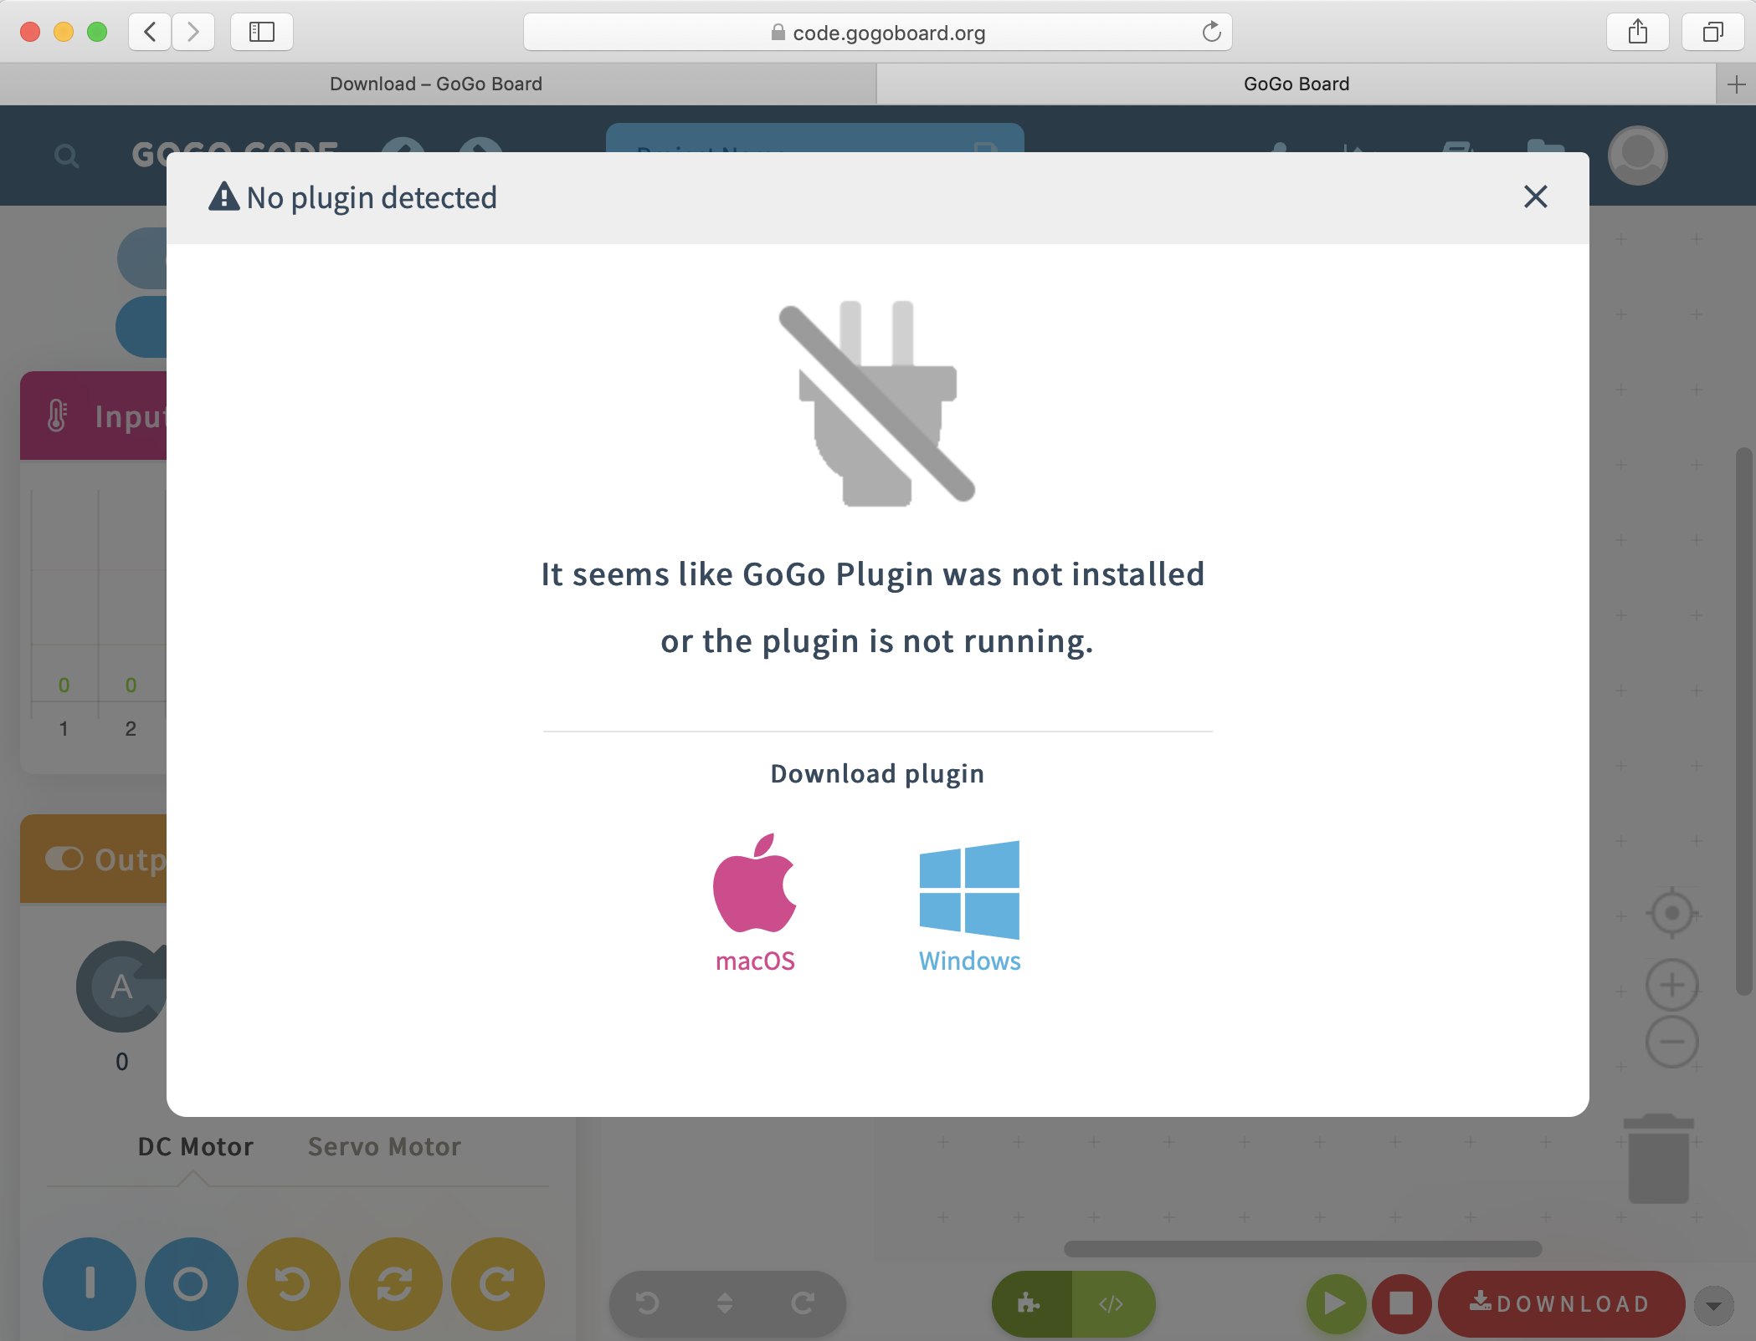
https://code.gogoboard.org/#/program

Slide 4
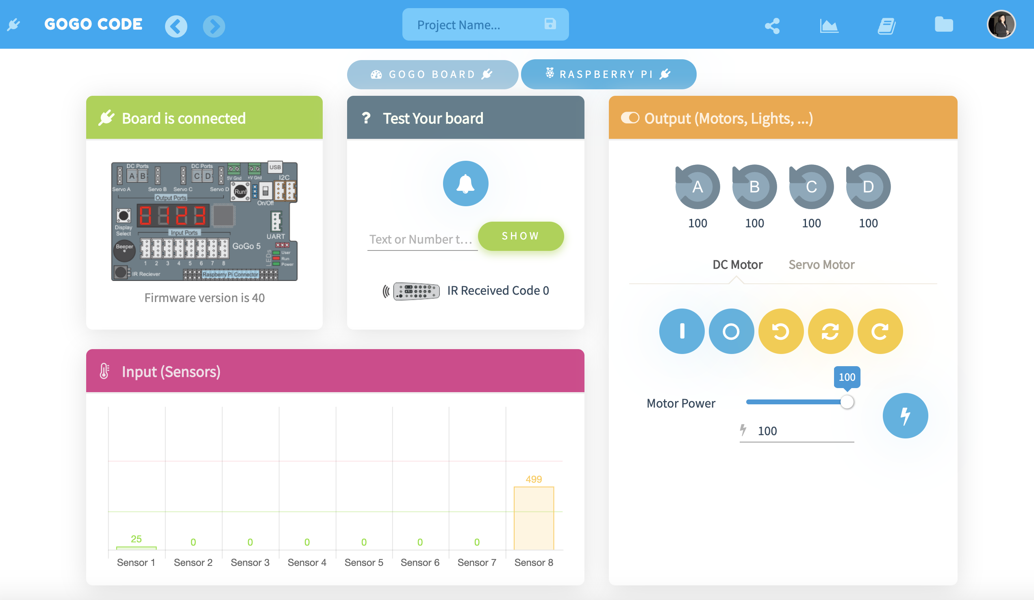
Control panels

Slide 5
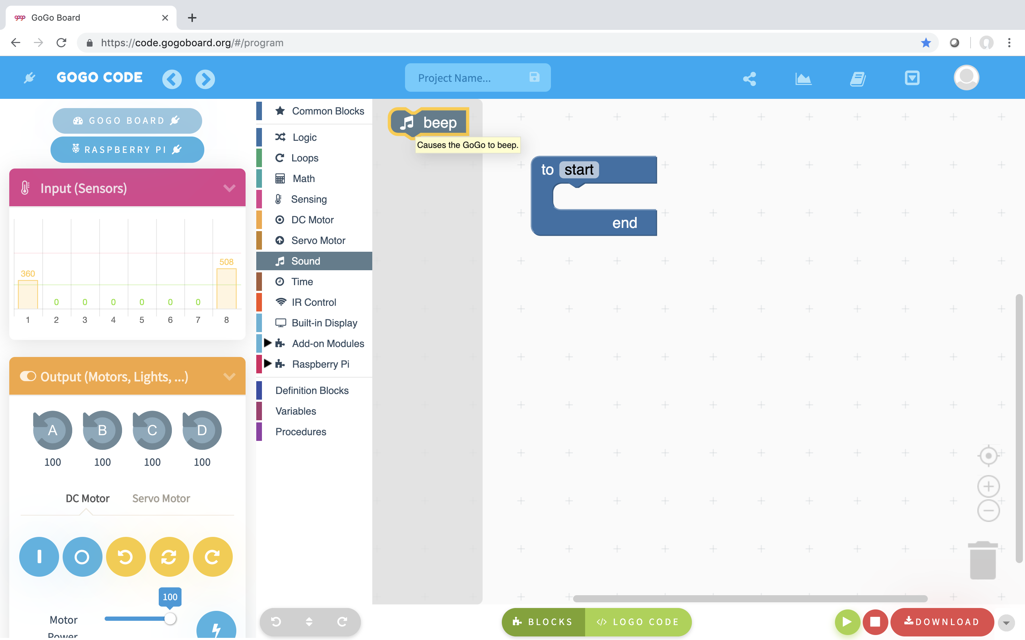
Simple procedure - Sound
Insert a ”Beep” block into the
Procedure block!

Slide 6
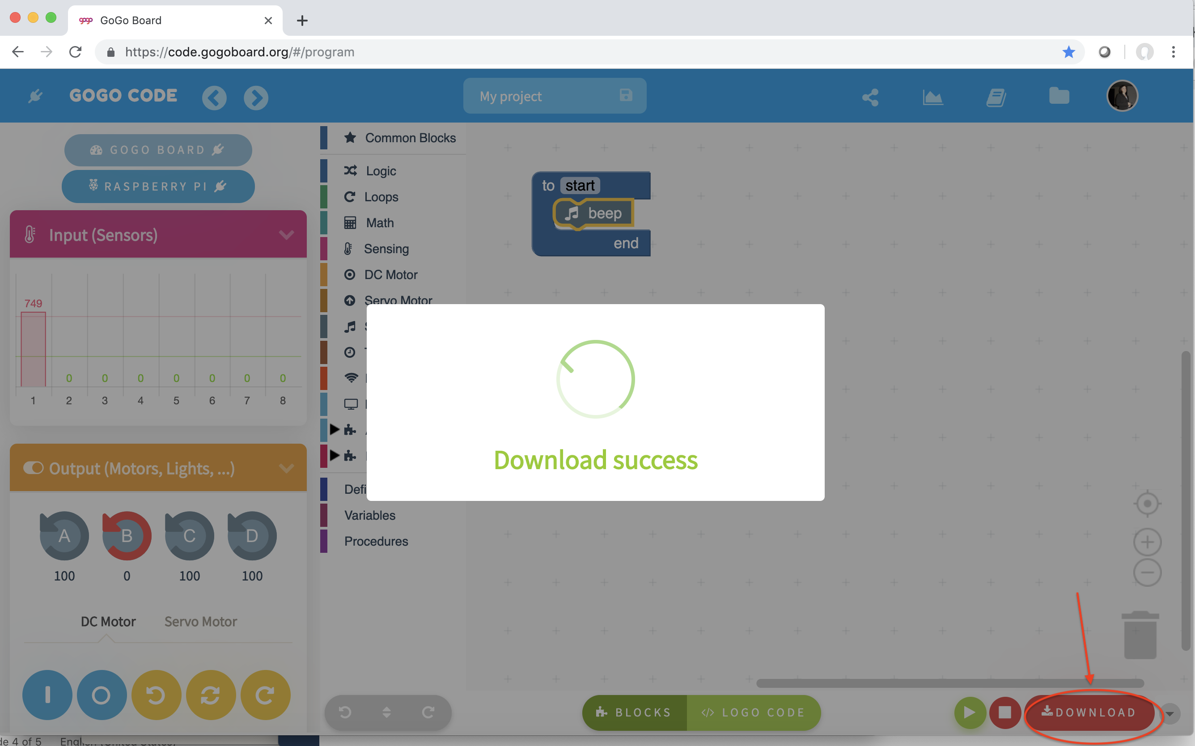
Simple procedure - Sound
”Download” the program to the GoGo Board!

Slide 7
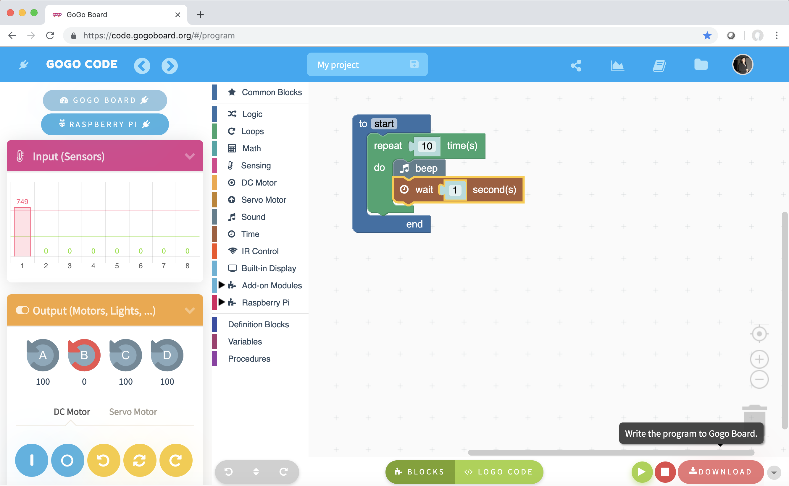
Simple procedure – Sound, insert a loop
Explore using a “Repeat” and a “Wait” blocks
”Download” the program to the GoGo Board!

Slide 8
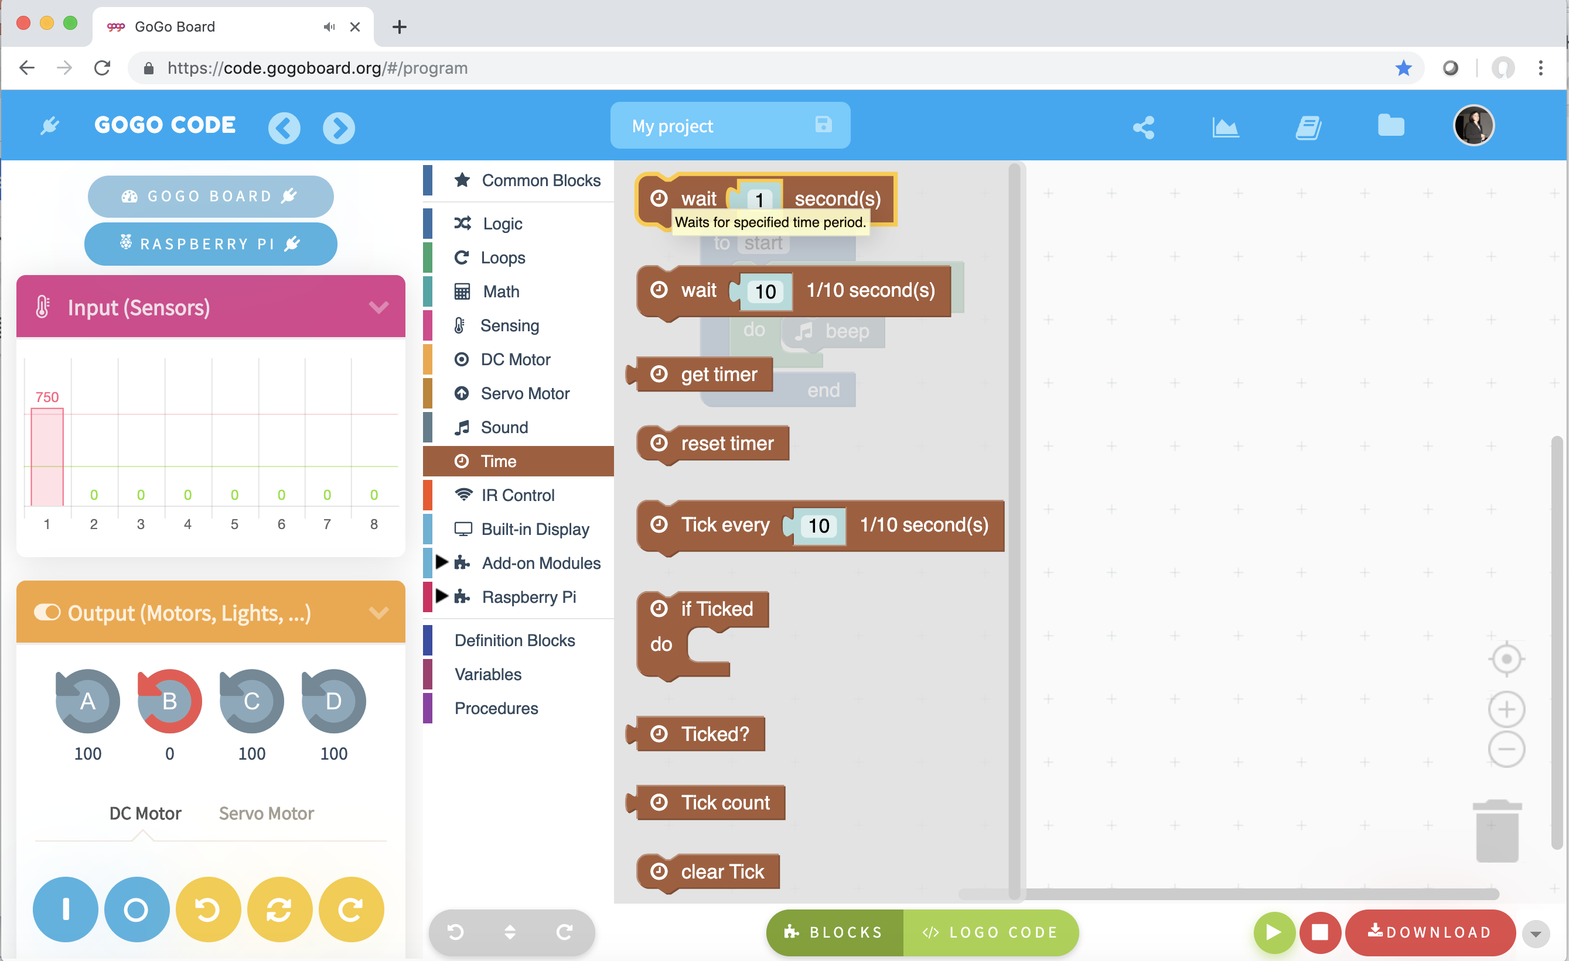
Simple procedure – Sound, insert a loop
What happens without a “Wait” block?

Slide 9
Simple procedure – Sound, insert a loop
Explore using a “Repeat” and a “Wait” blocks
”Download” the program to the GoGo Board!

Slide 10
Explore!! (10 min)

Slide 11
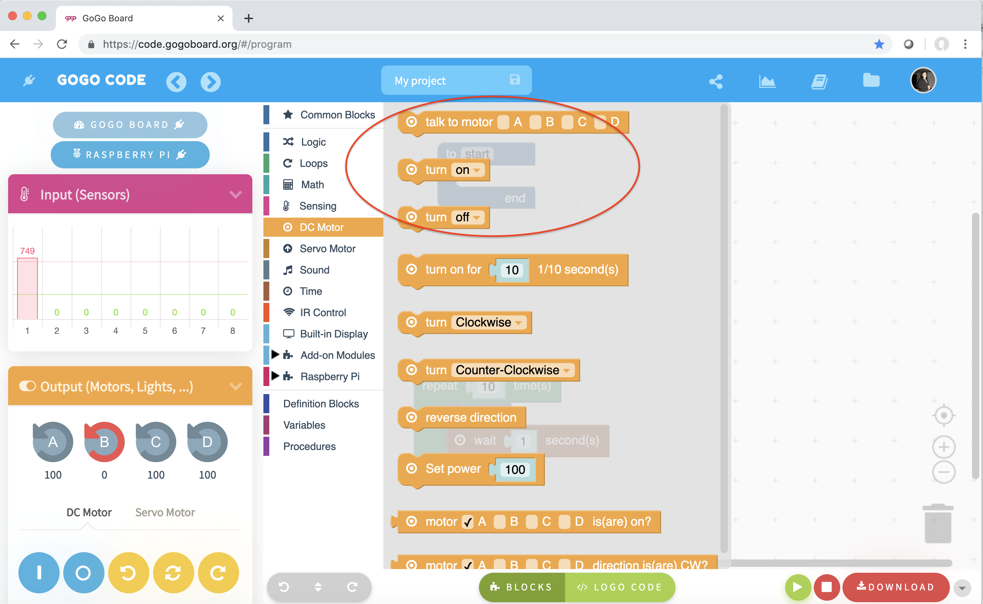
Simple procedure - Motors
Connect Motor(s)
You need to a block to “talk” to the motor(s)
You need to a block to turn motor(s) on and off

Slide 12
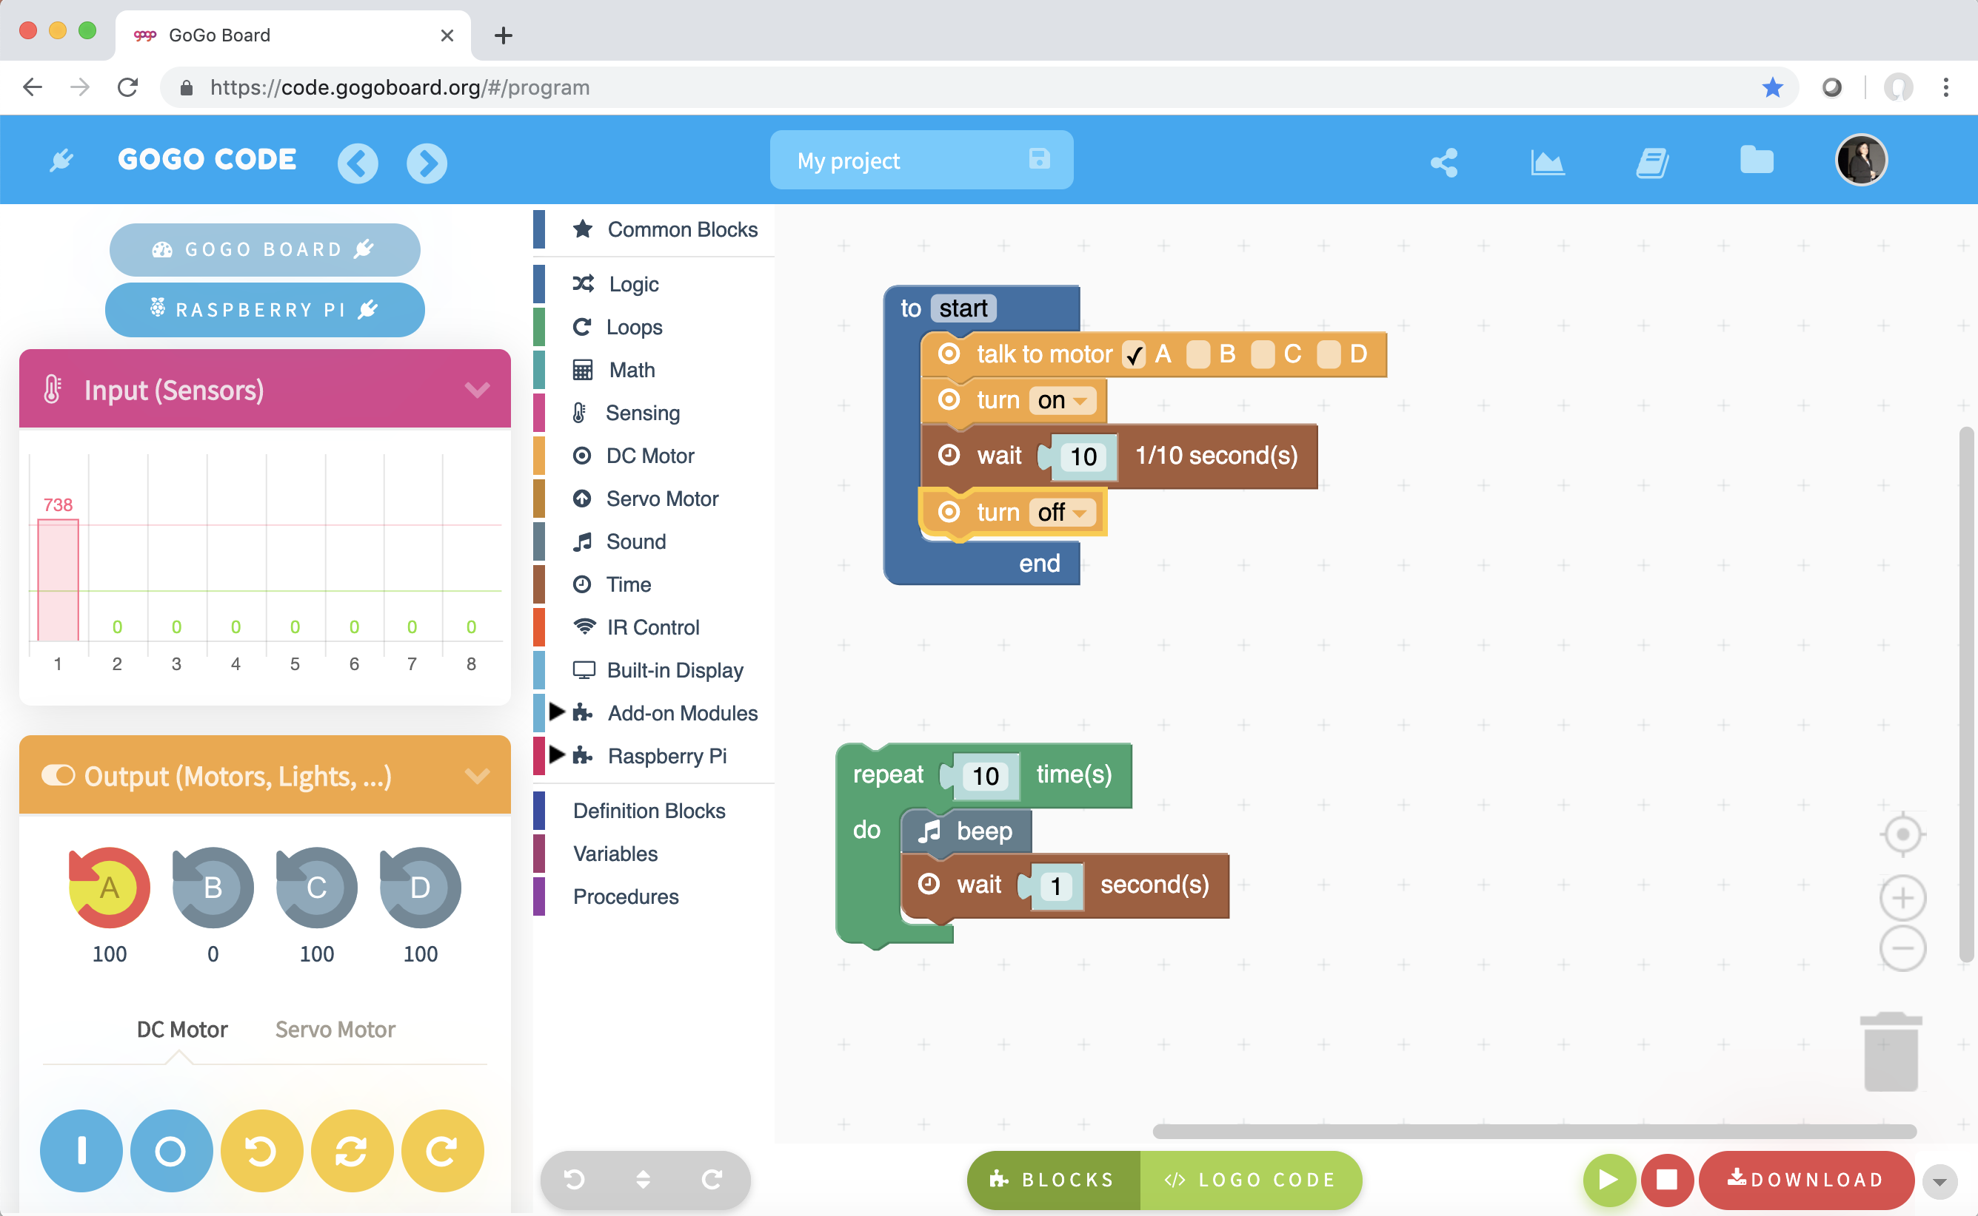
Simple procedure - Motors
”Download” the program to the GoGo Board!

Slide 13
Challenges (15 min): - Combine movement and sound - Build a moving artifact and program it to move back and forth - Others?

Slide 14
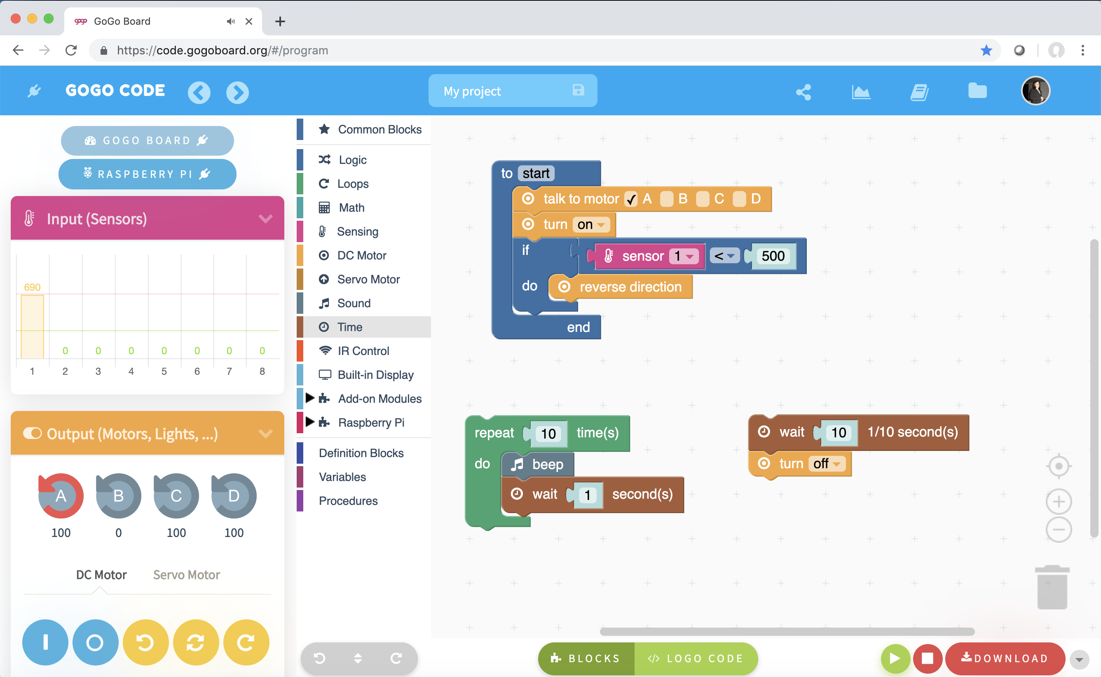
Control Motors
What if we can control the movement with a sensor?
Select a sensor and connect it to a sensor port!

Slide 15
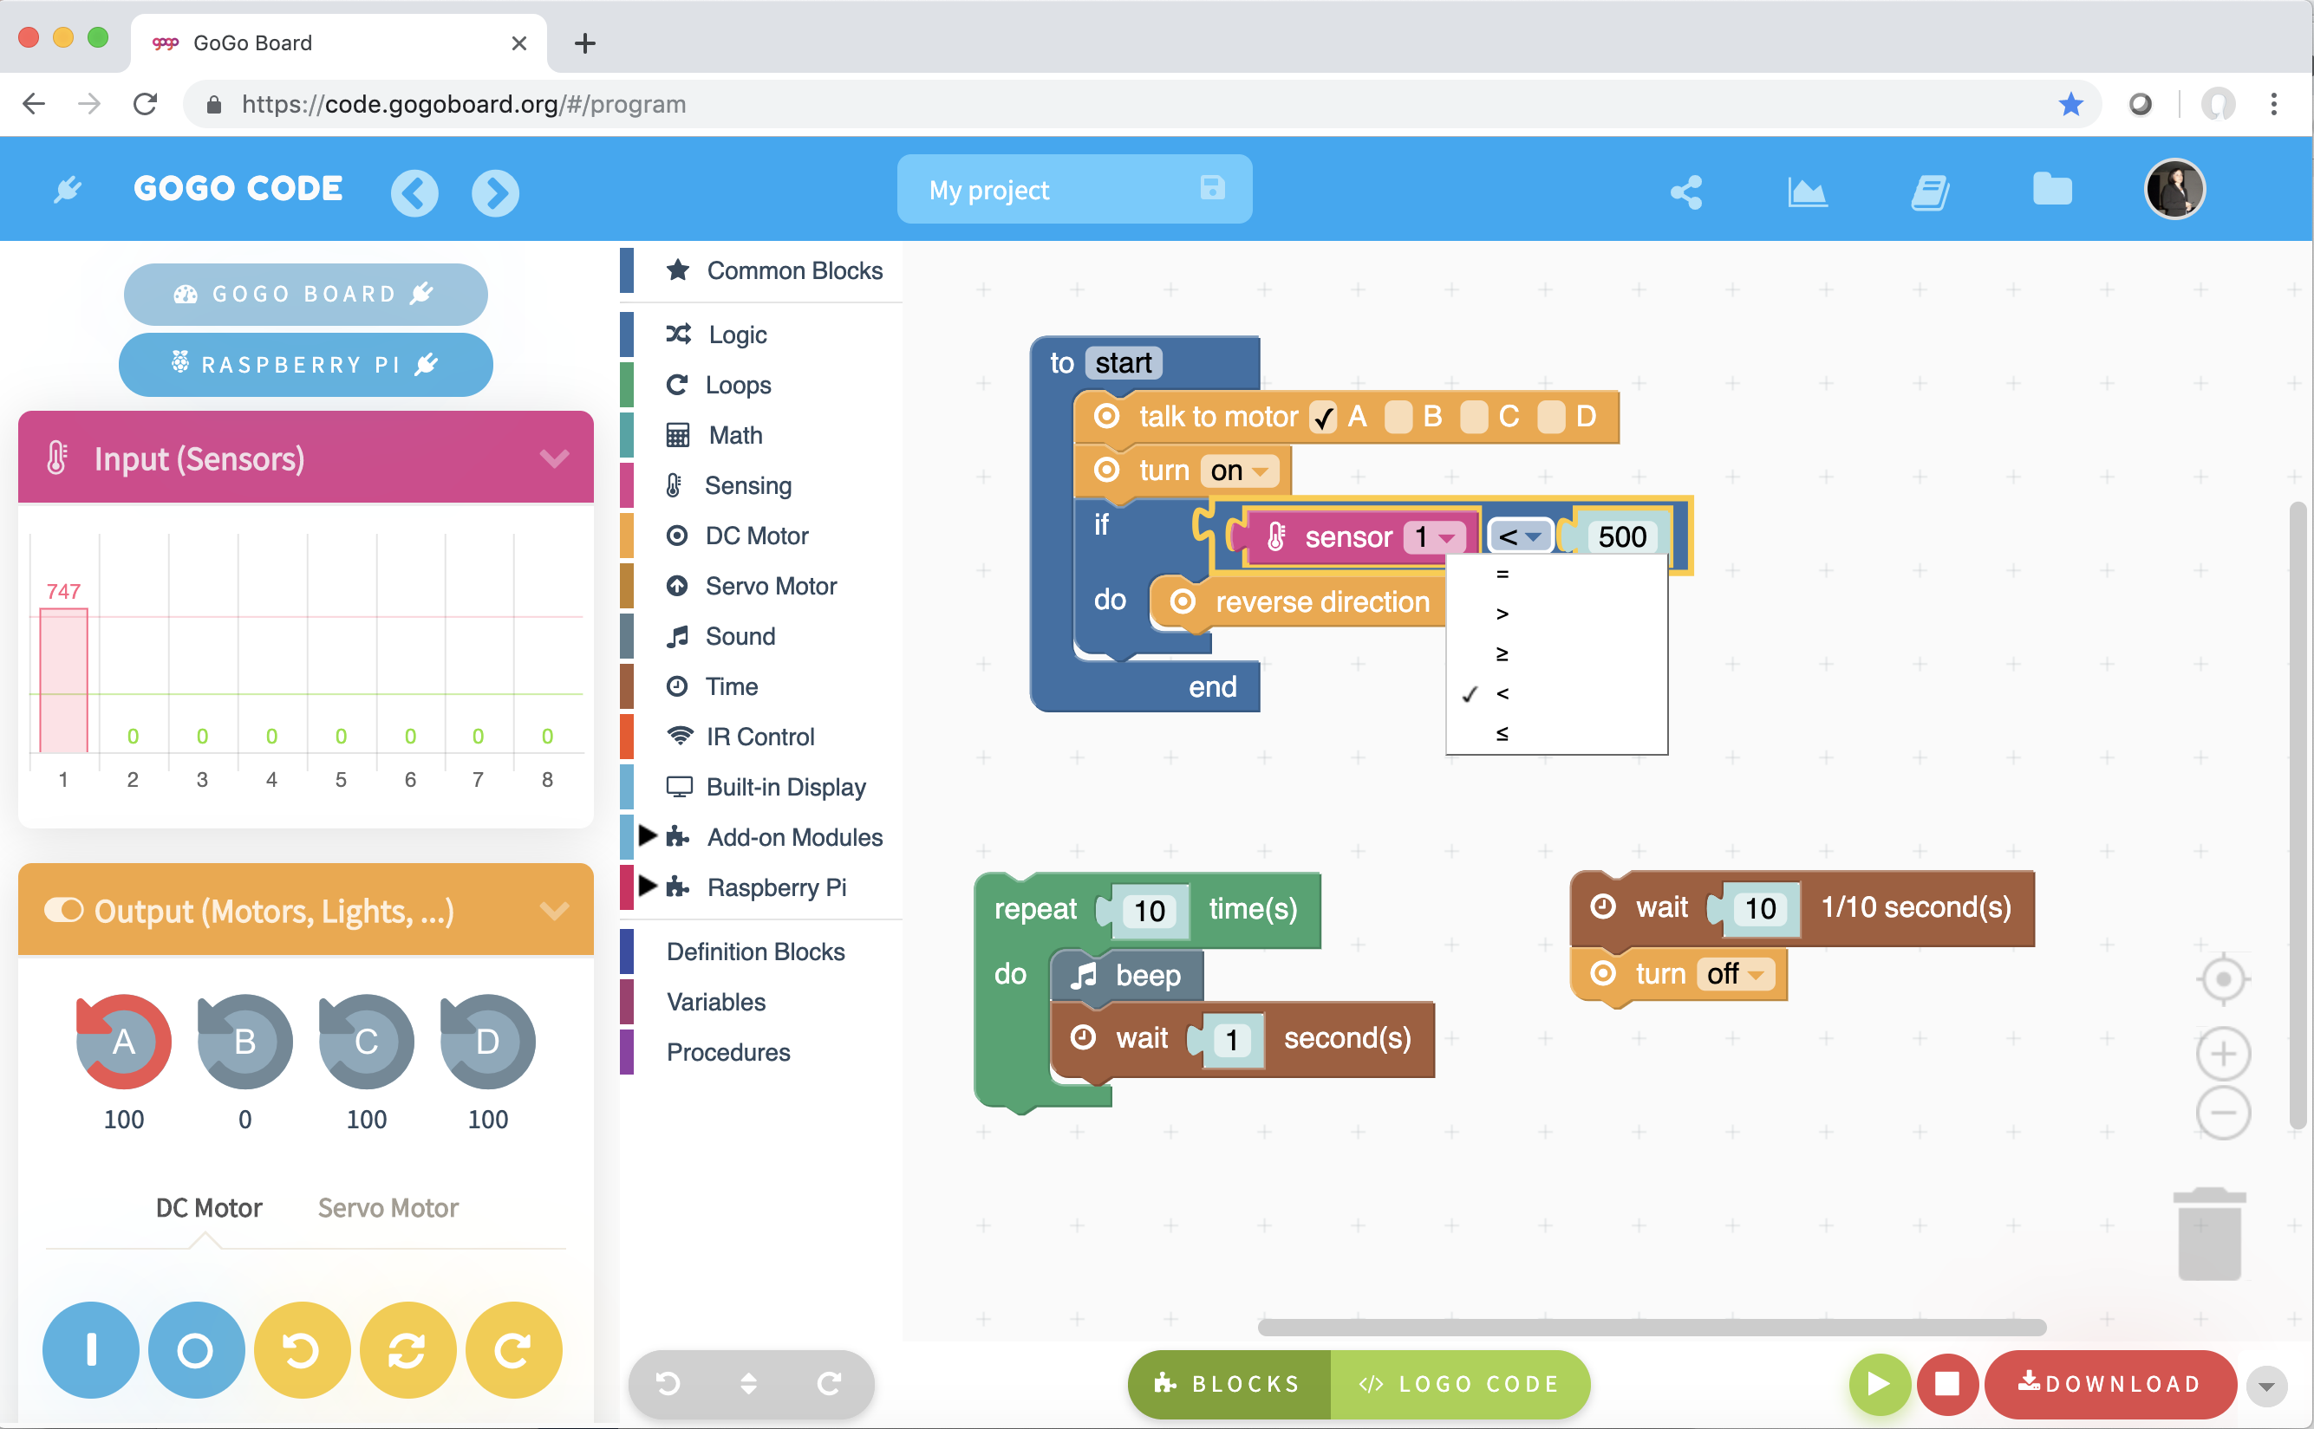
Control Motors
A light sensor reading is smaller than 500 when is dark!
Calibrate your sensor!

Slide 16
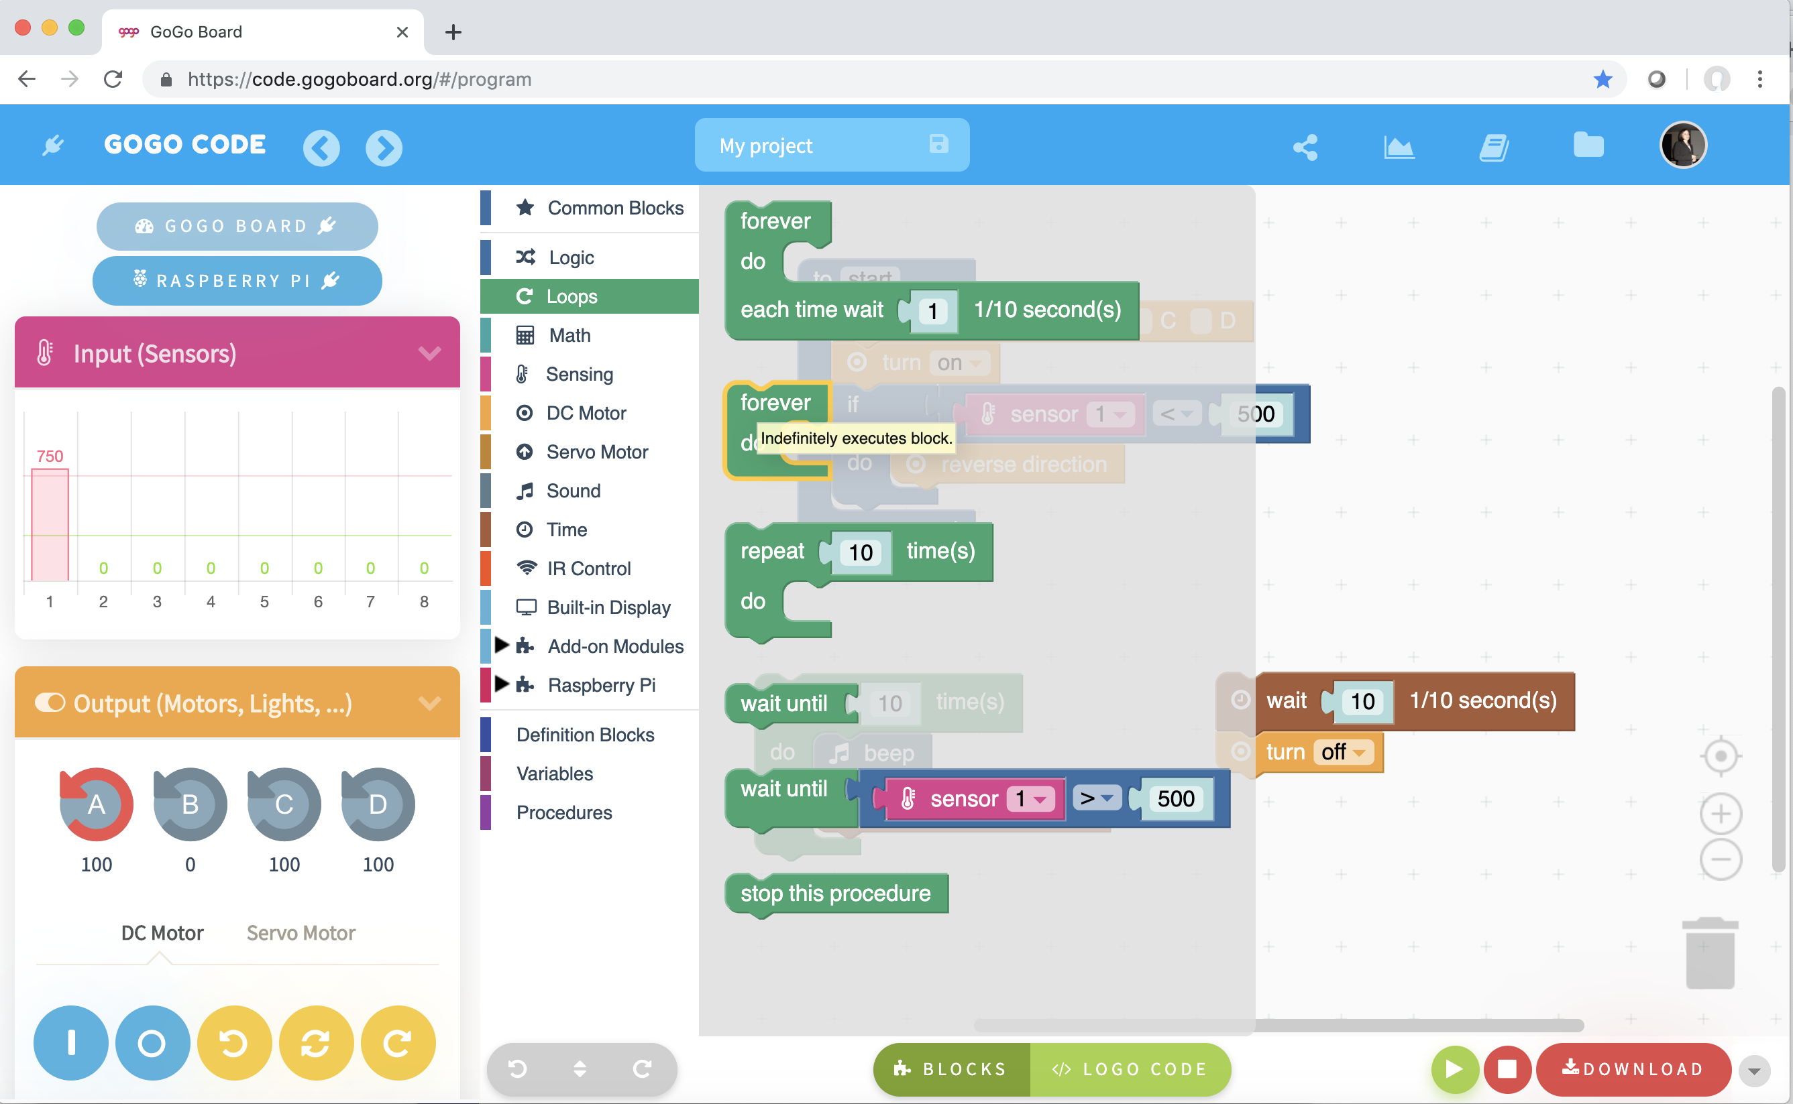
Control Motors
What happens without a ”Repeat” block?

Slide 17
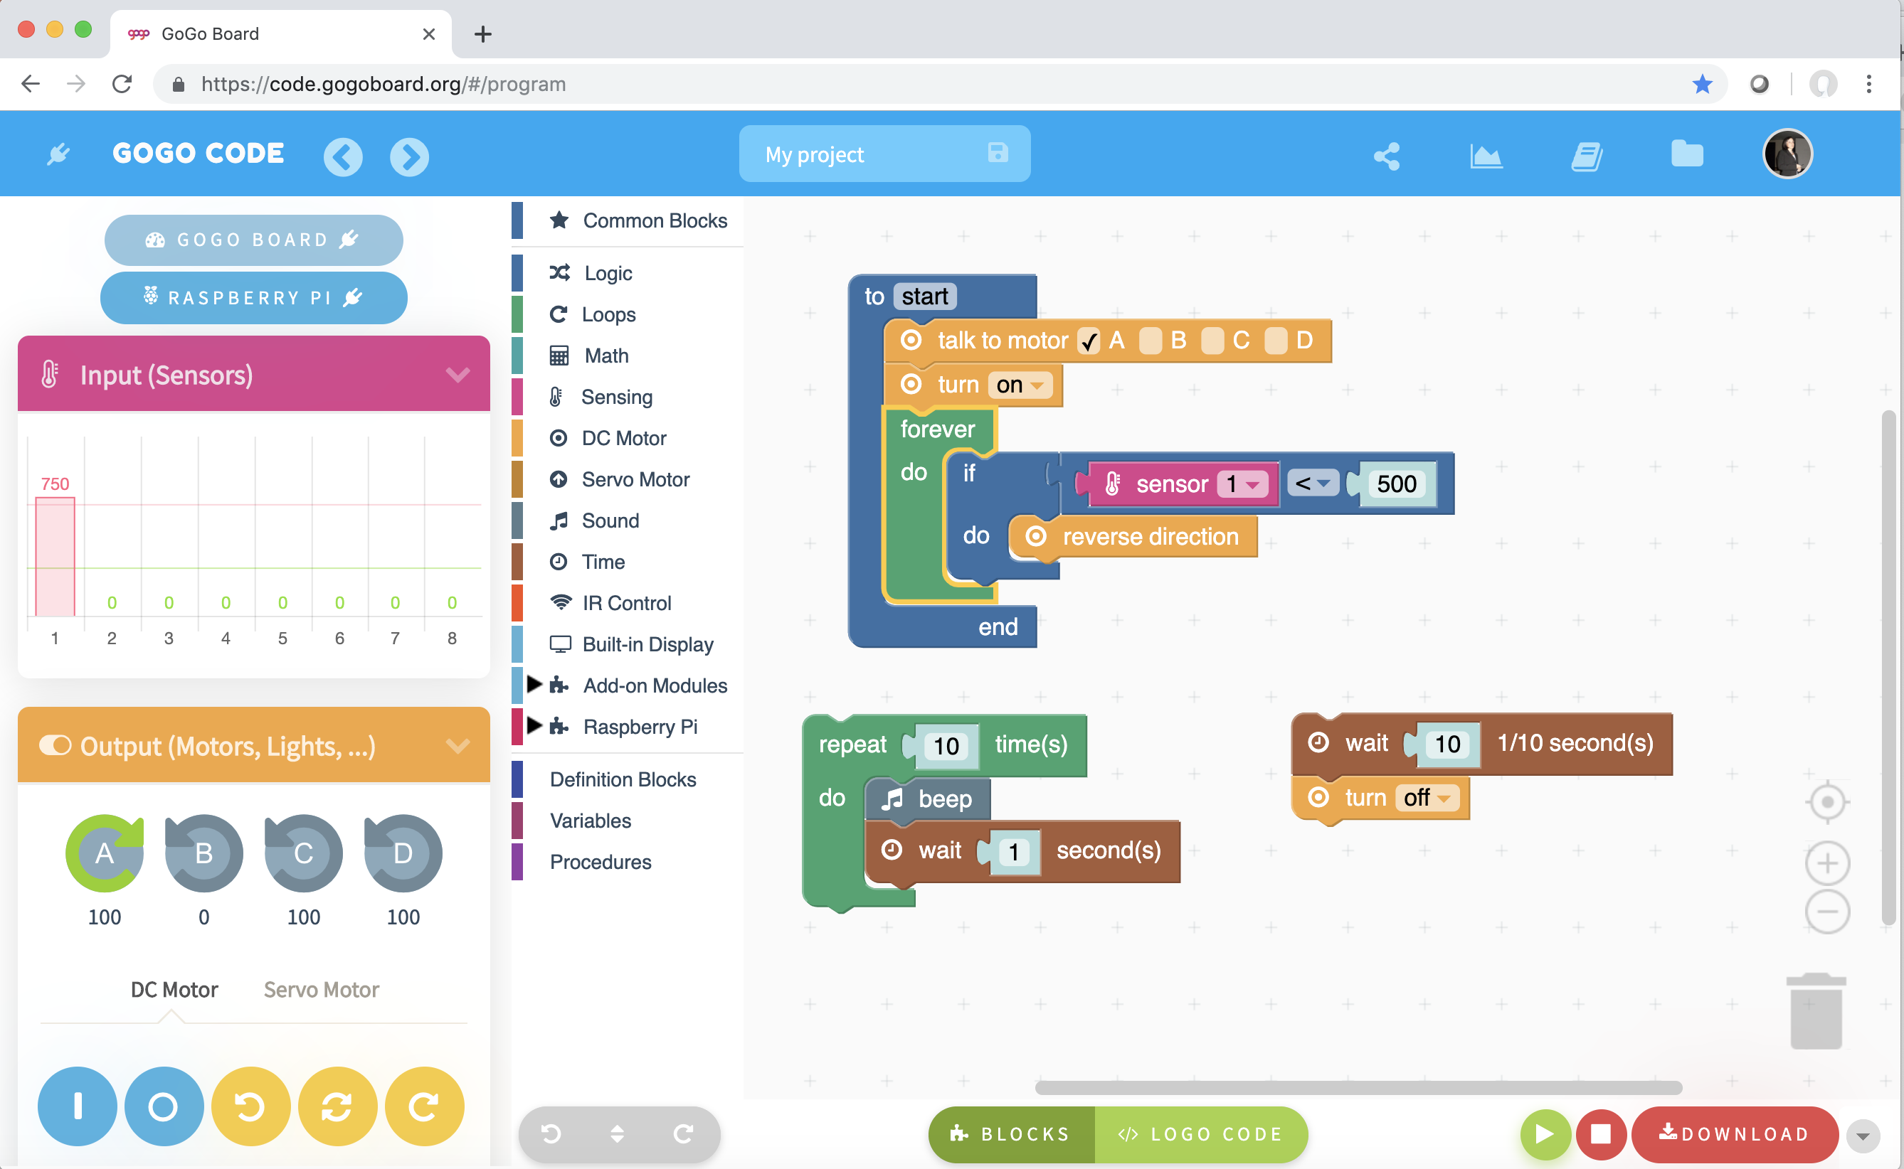
Control Motors
Explore and build your own artifact!

Slide 18
Challenges (30 min): - Build a house alarm - Turn a light on when it is dark - Start a motor when soil is too dry - Build a small car that avoids obstacles - Other ideas?

Slide 19
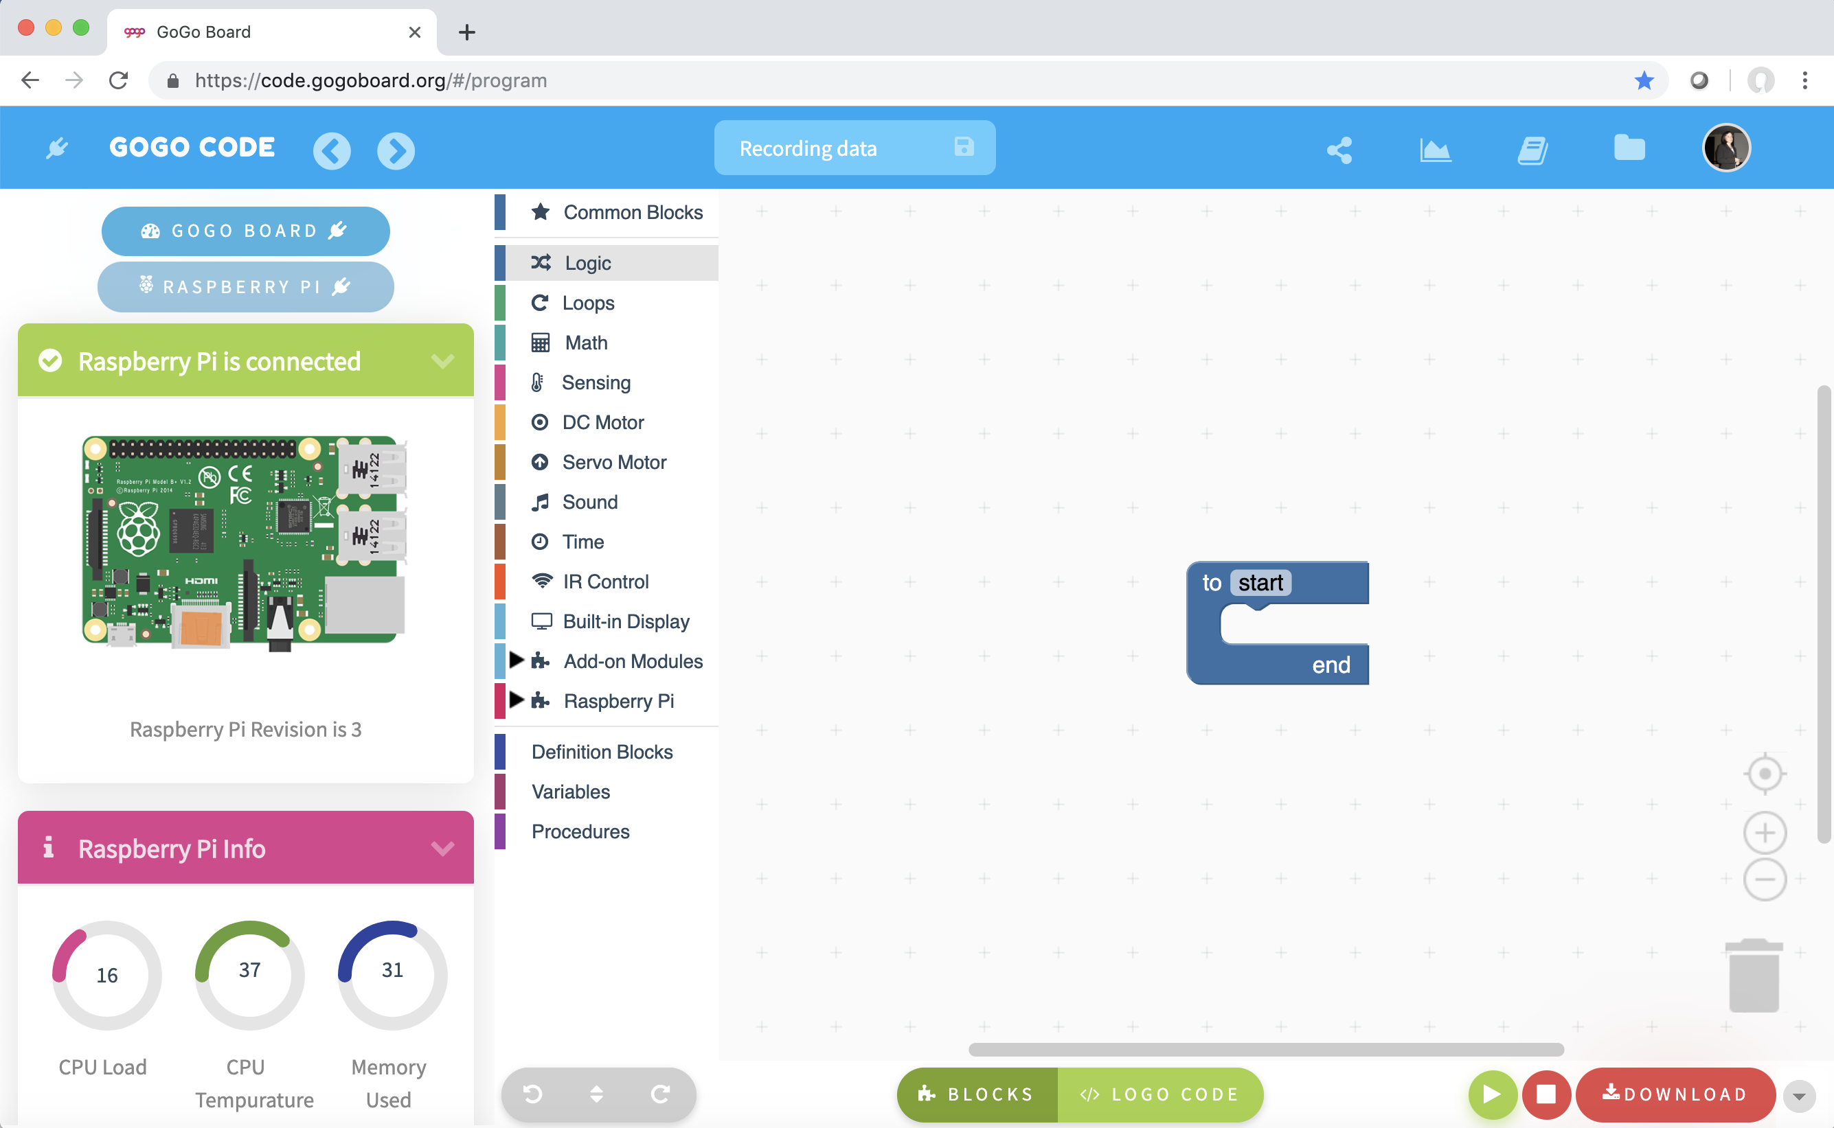
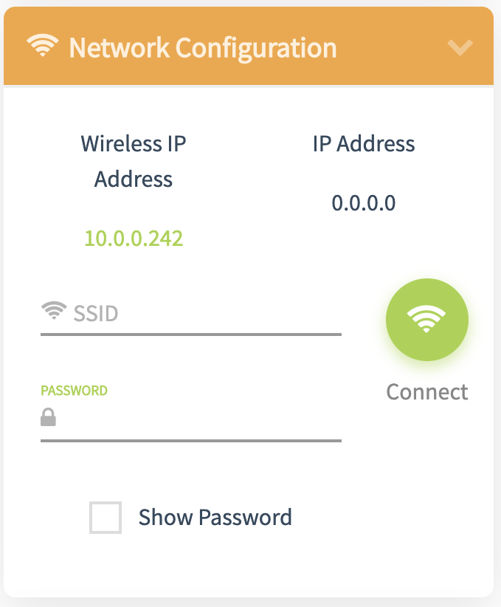
Recording data
Connect Rasberry Pi!

Slide 20
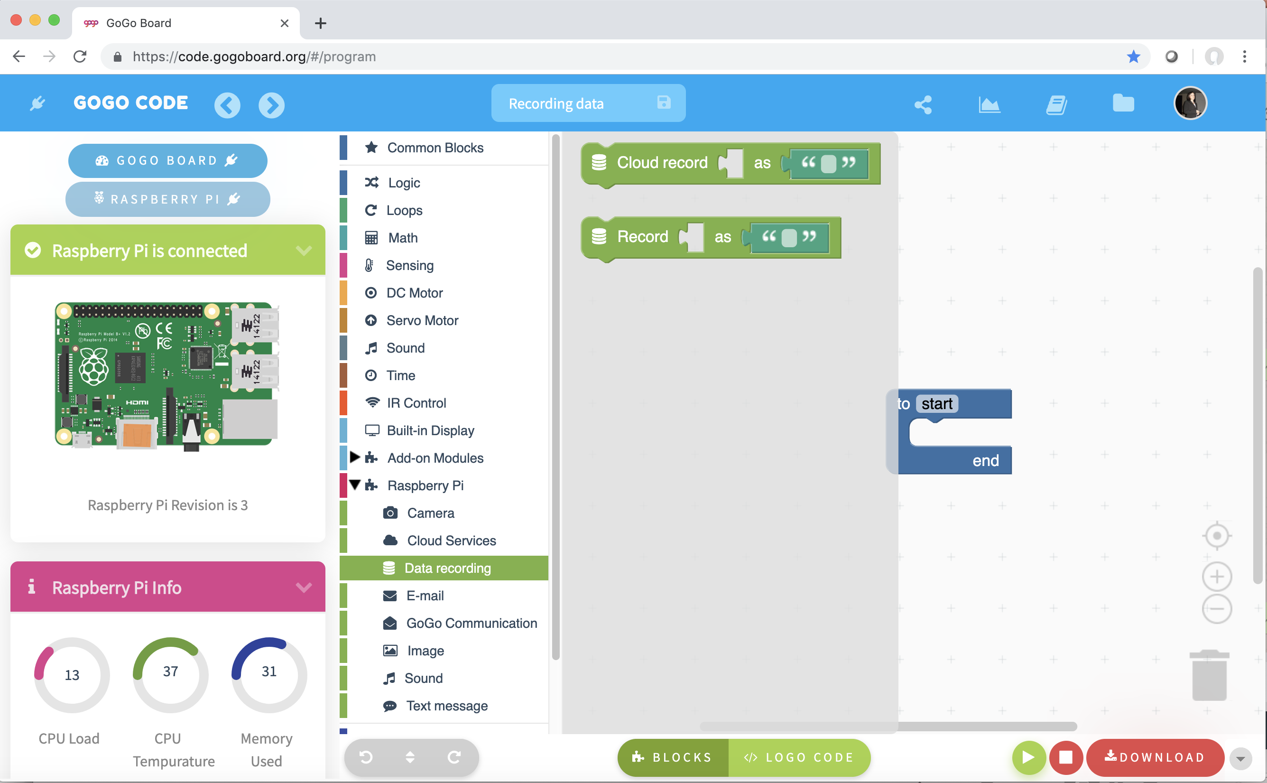
Recording data
Use “Record” block (from Rasberry Pi menu option)

Slide 21
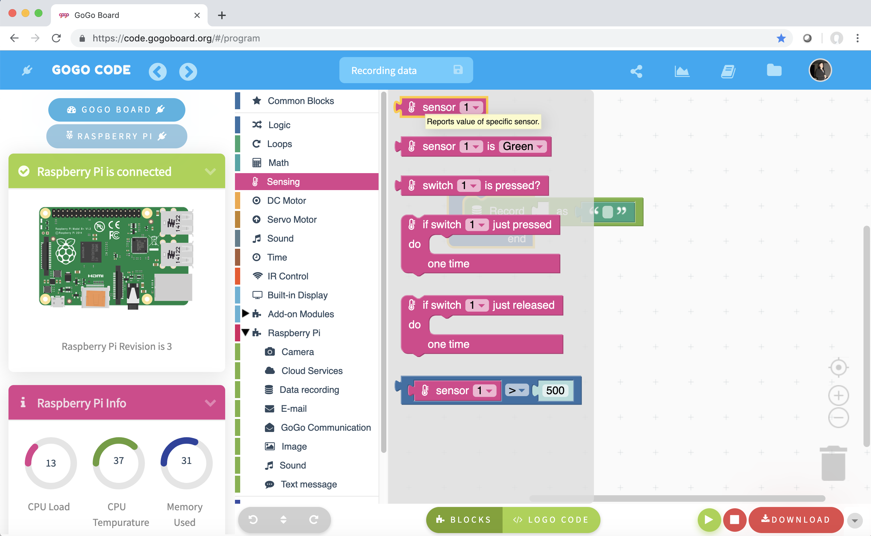
Recording data
Use “Record” block (from Rasberry Pi menu option)
Add a “sensor” block.

Slide 22
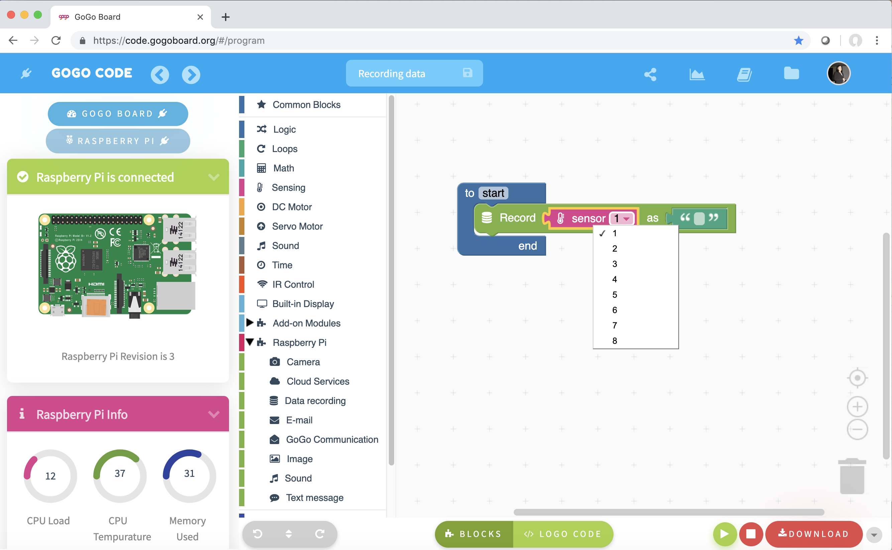
Recording data
Use “Record” block (from Rasberry Pi menu option)
Add a “sensor” block. Make sure to select the correct port!

Slide 23
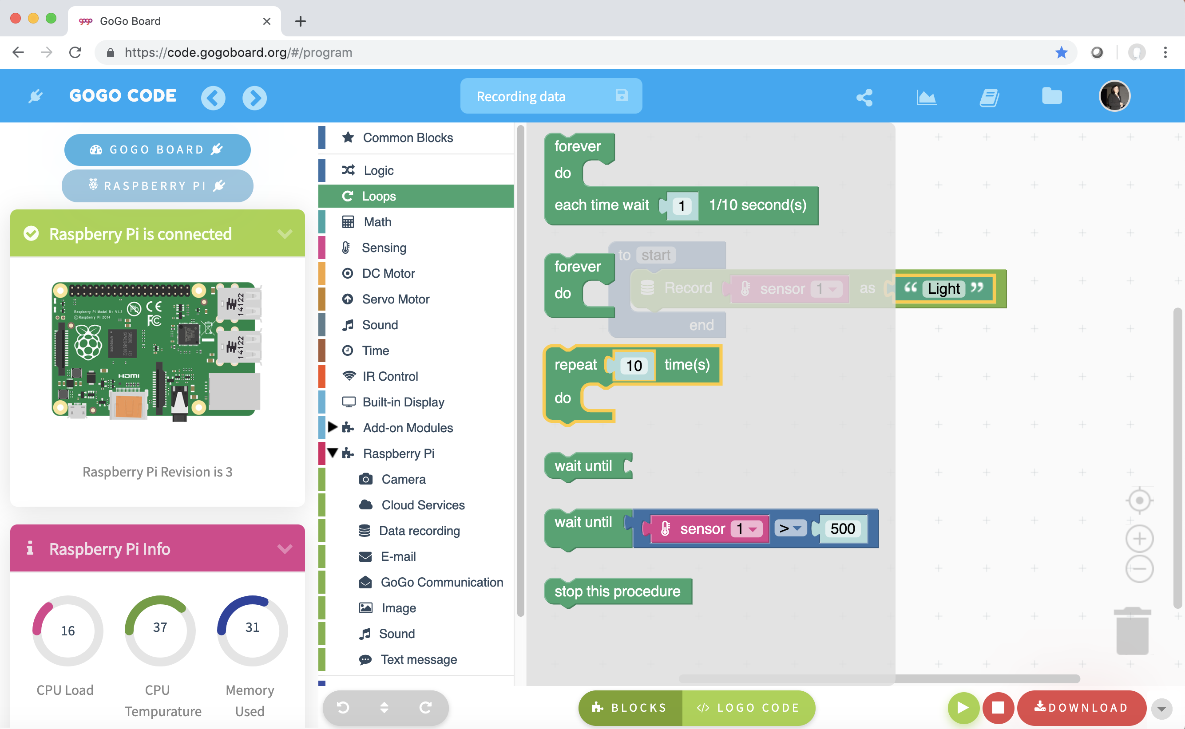
Recording data
Do we need a “Repeat” block?

Slide 24
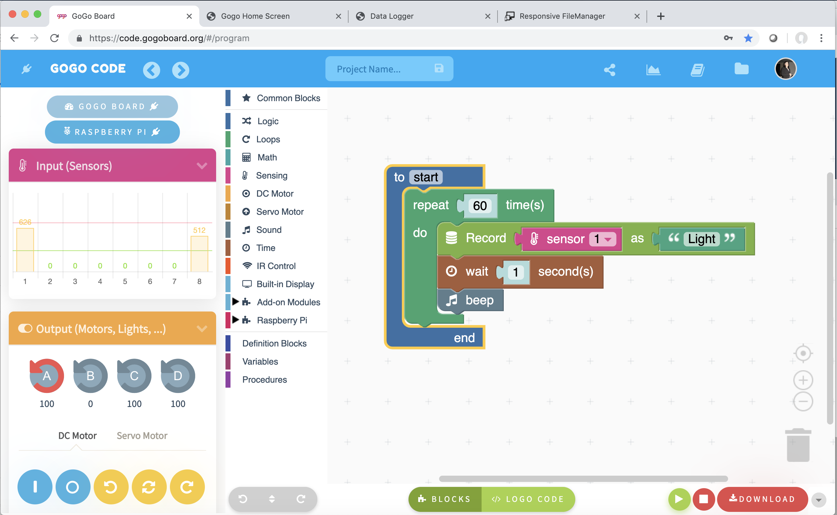
Recording data
Do we need a “Repeat” block?
How many times? How often we record?

Slide 25
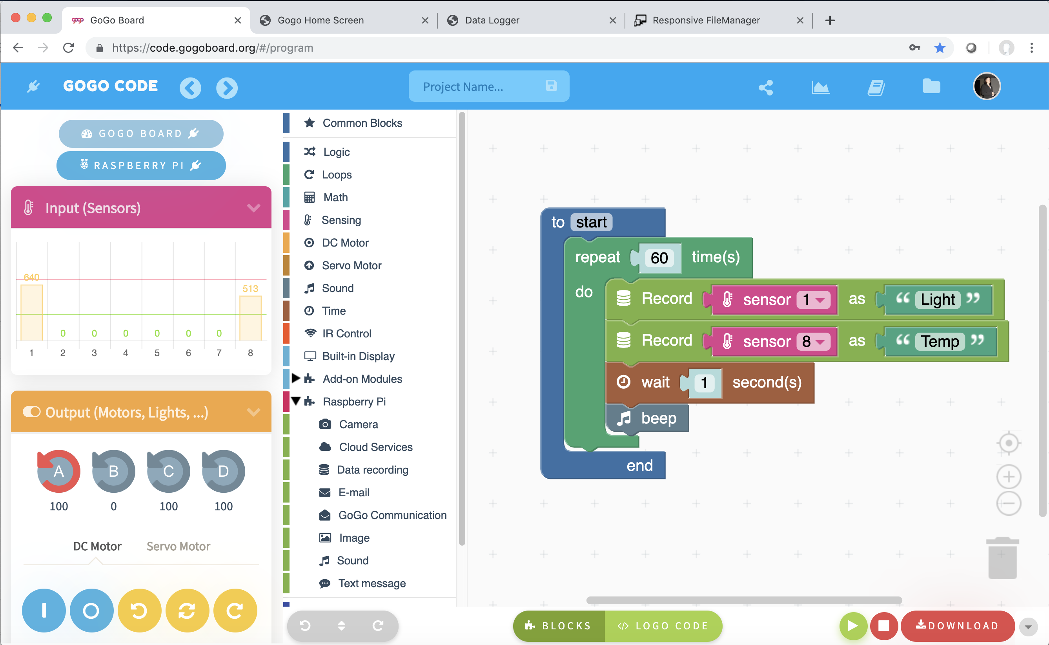
Recording data
Do we need a “Repeat” block?
How many times? How often we record?
What about 2 sensors?

Slide 26
Recording data
You can see data recording in real time!

Slide 27
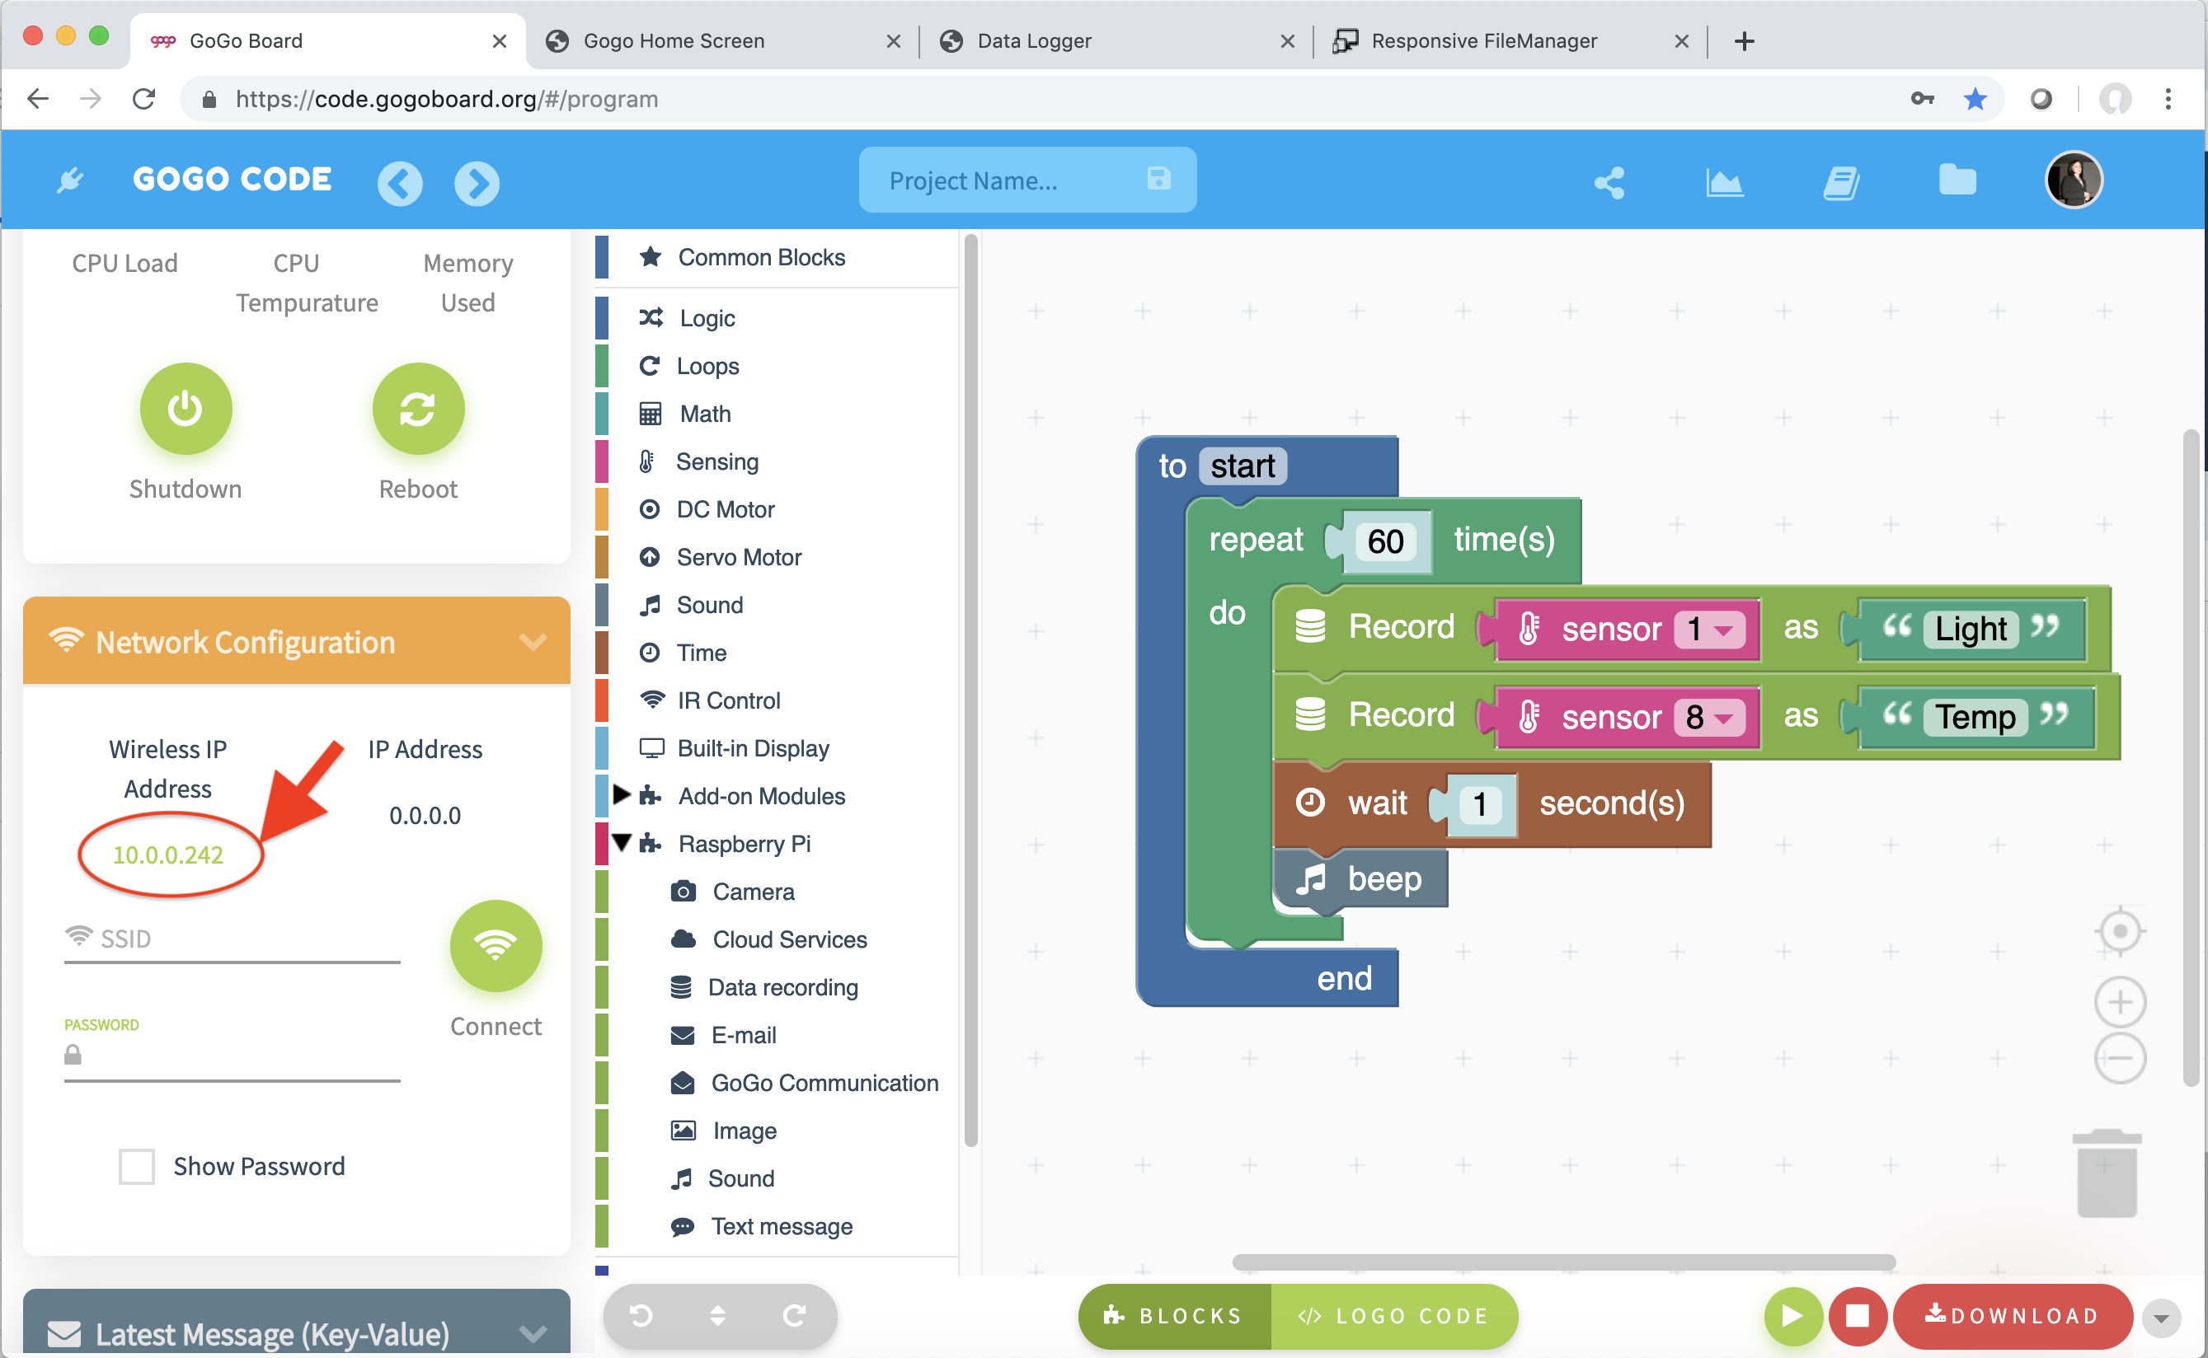
See recording in real time!
Click on the IP Address.

Slide 28
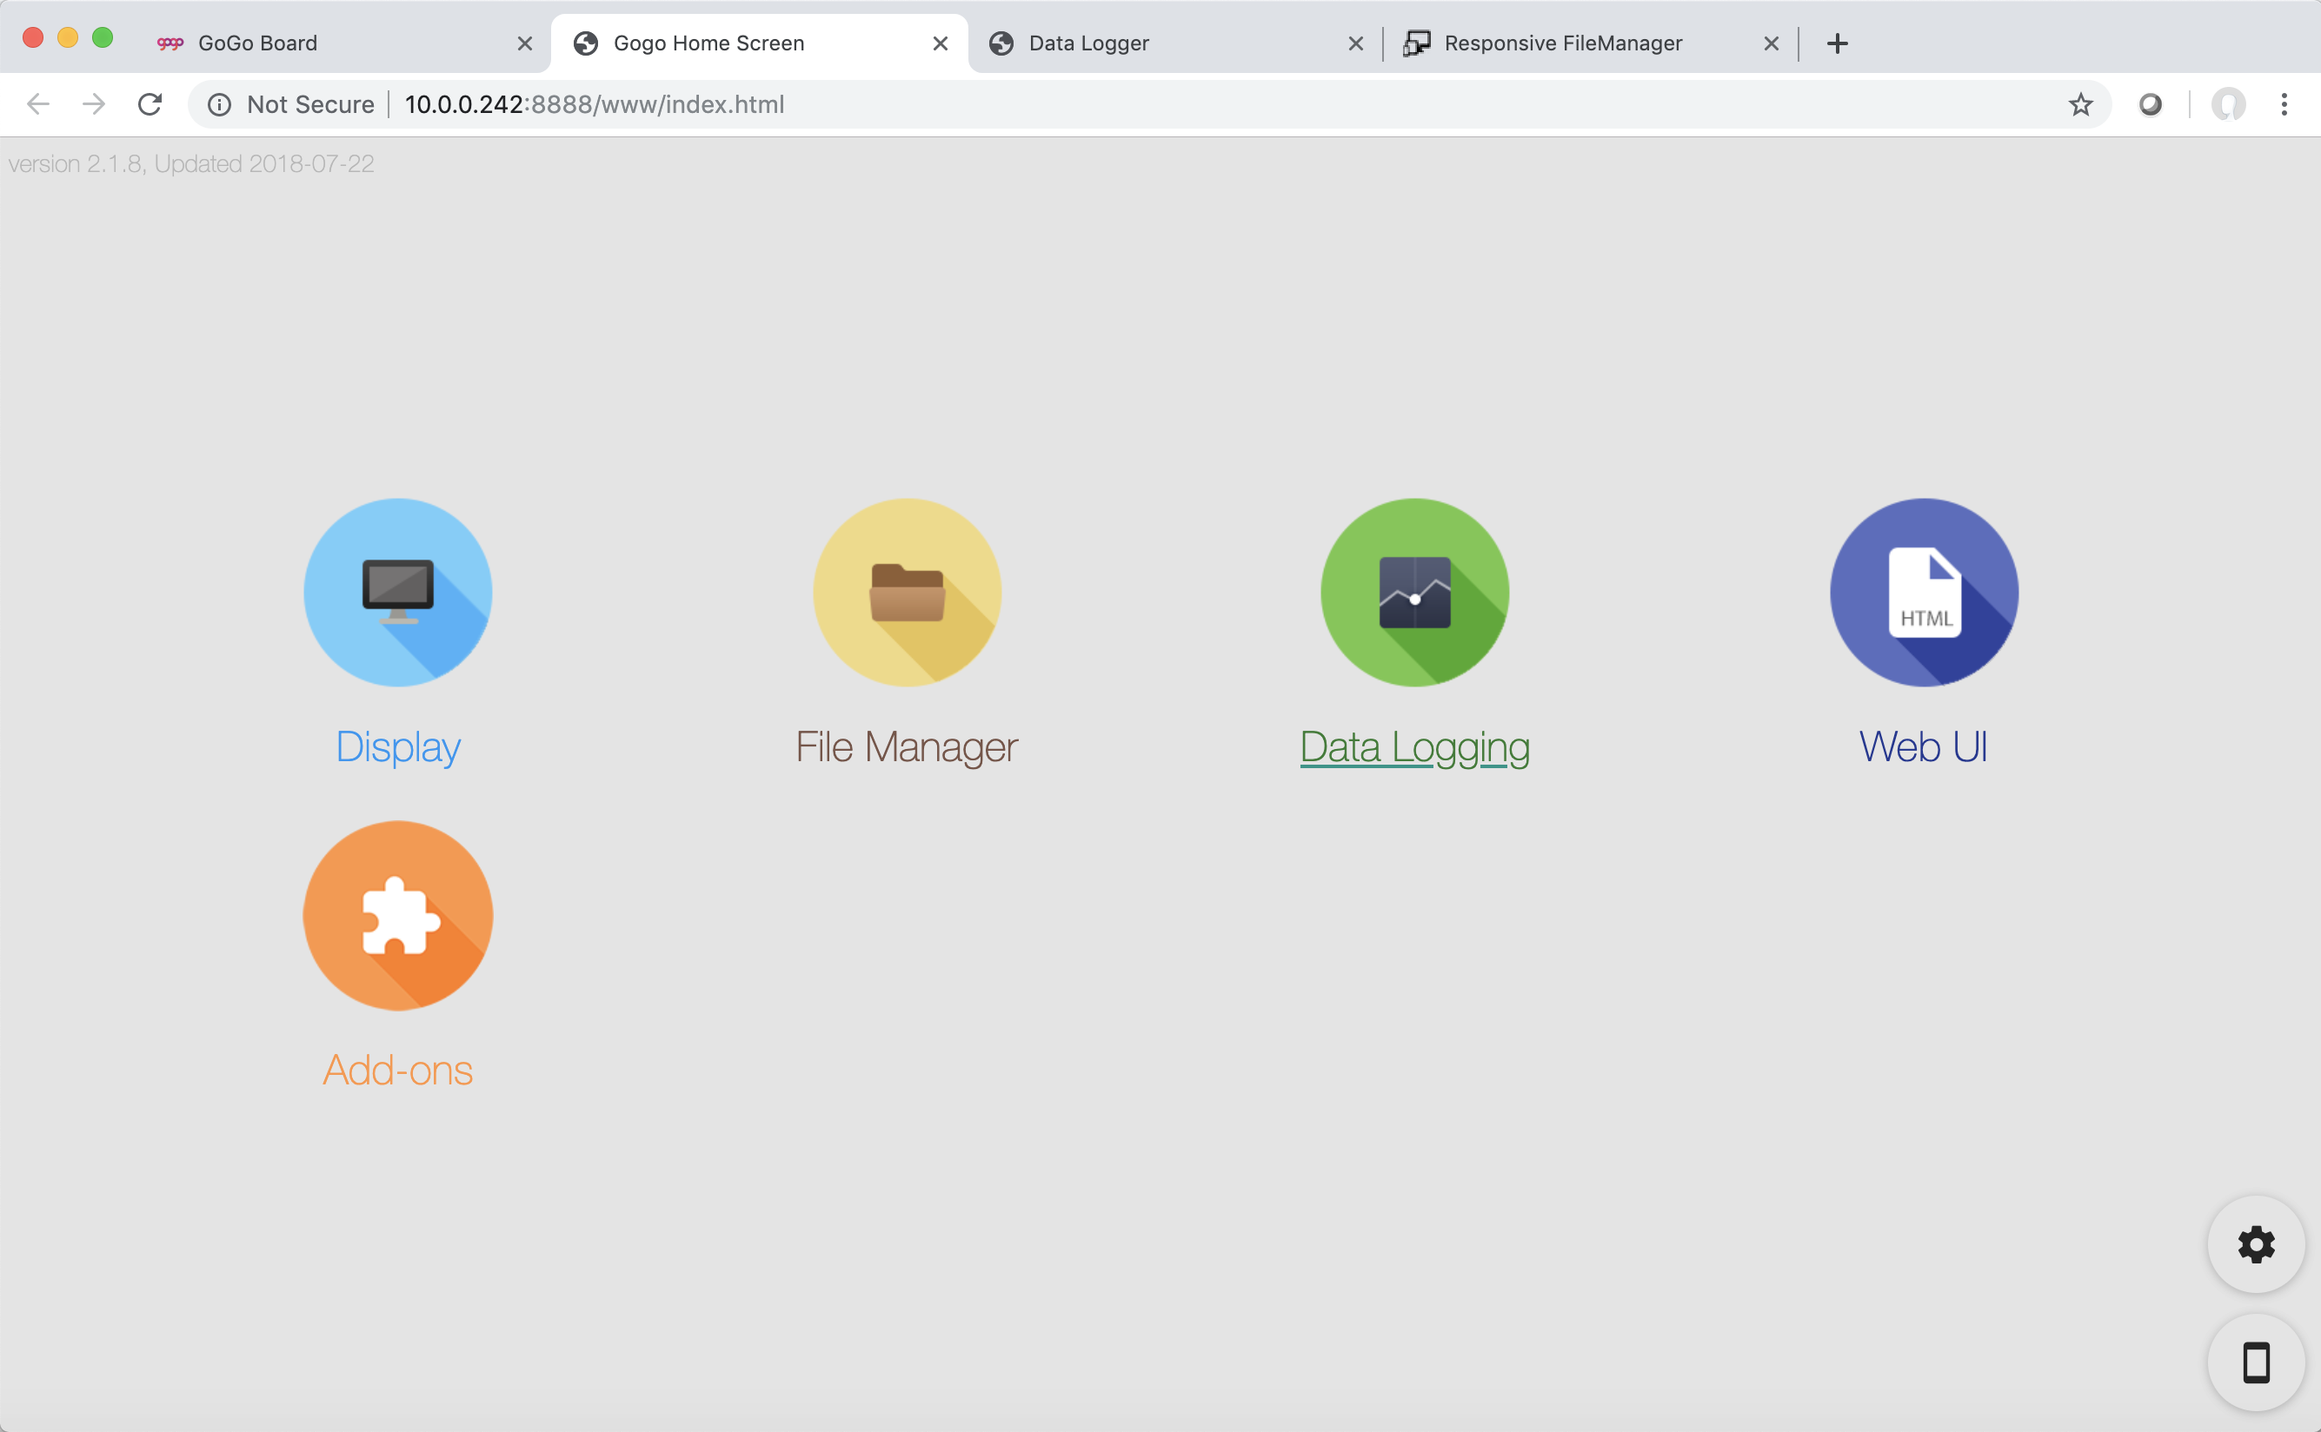
See recording in real time!
Select Data Logging!

Slide 29
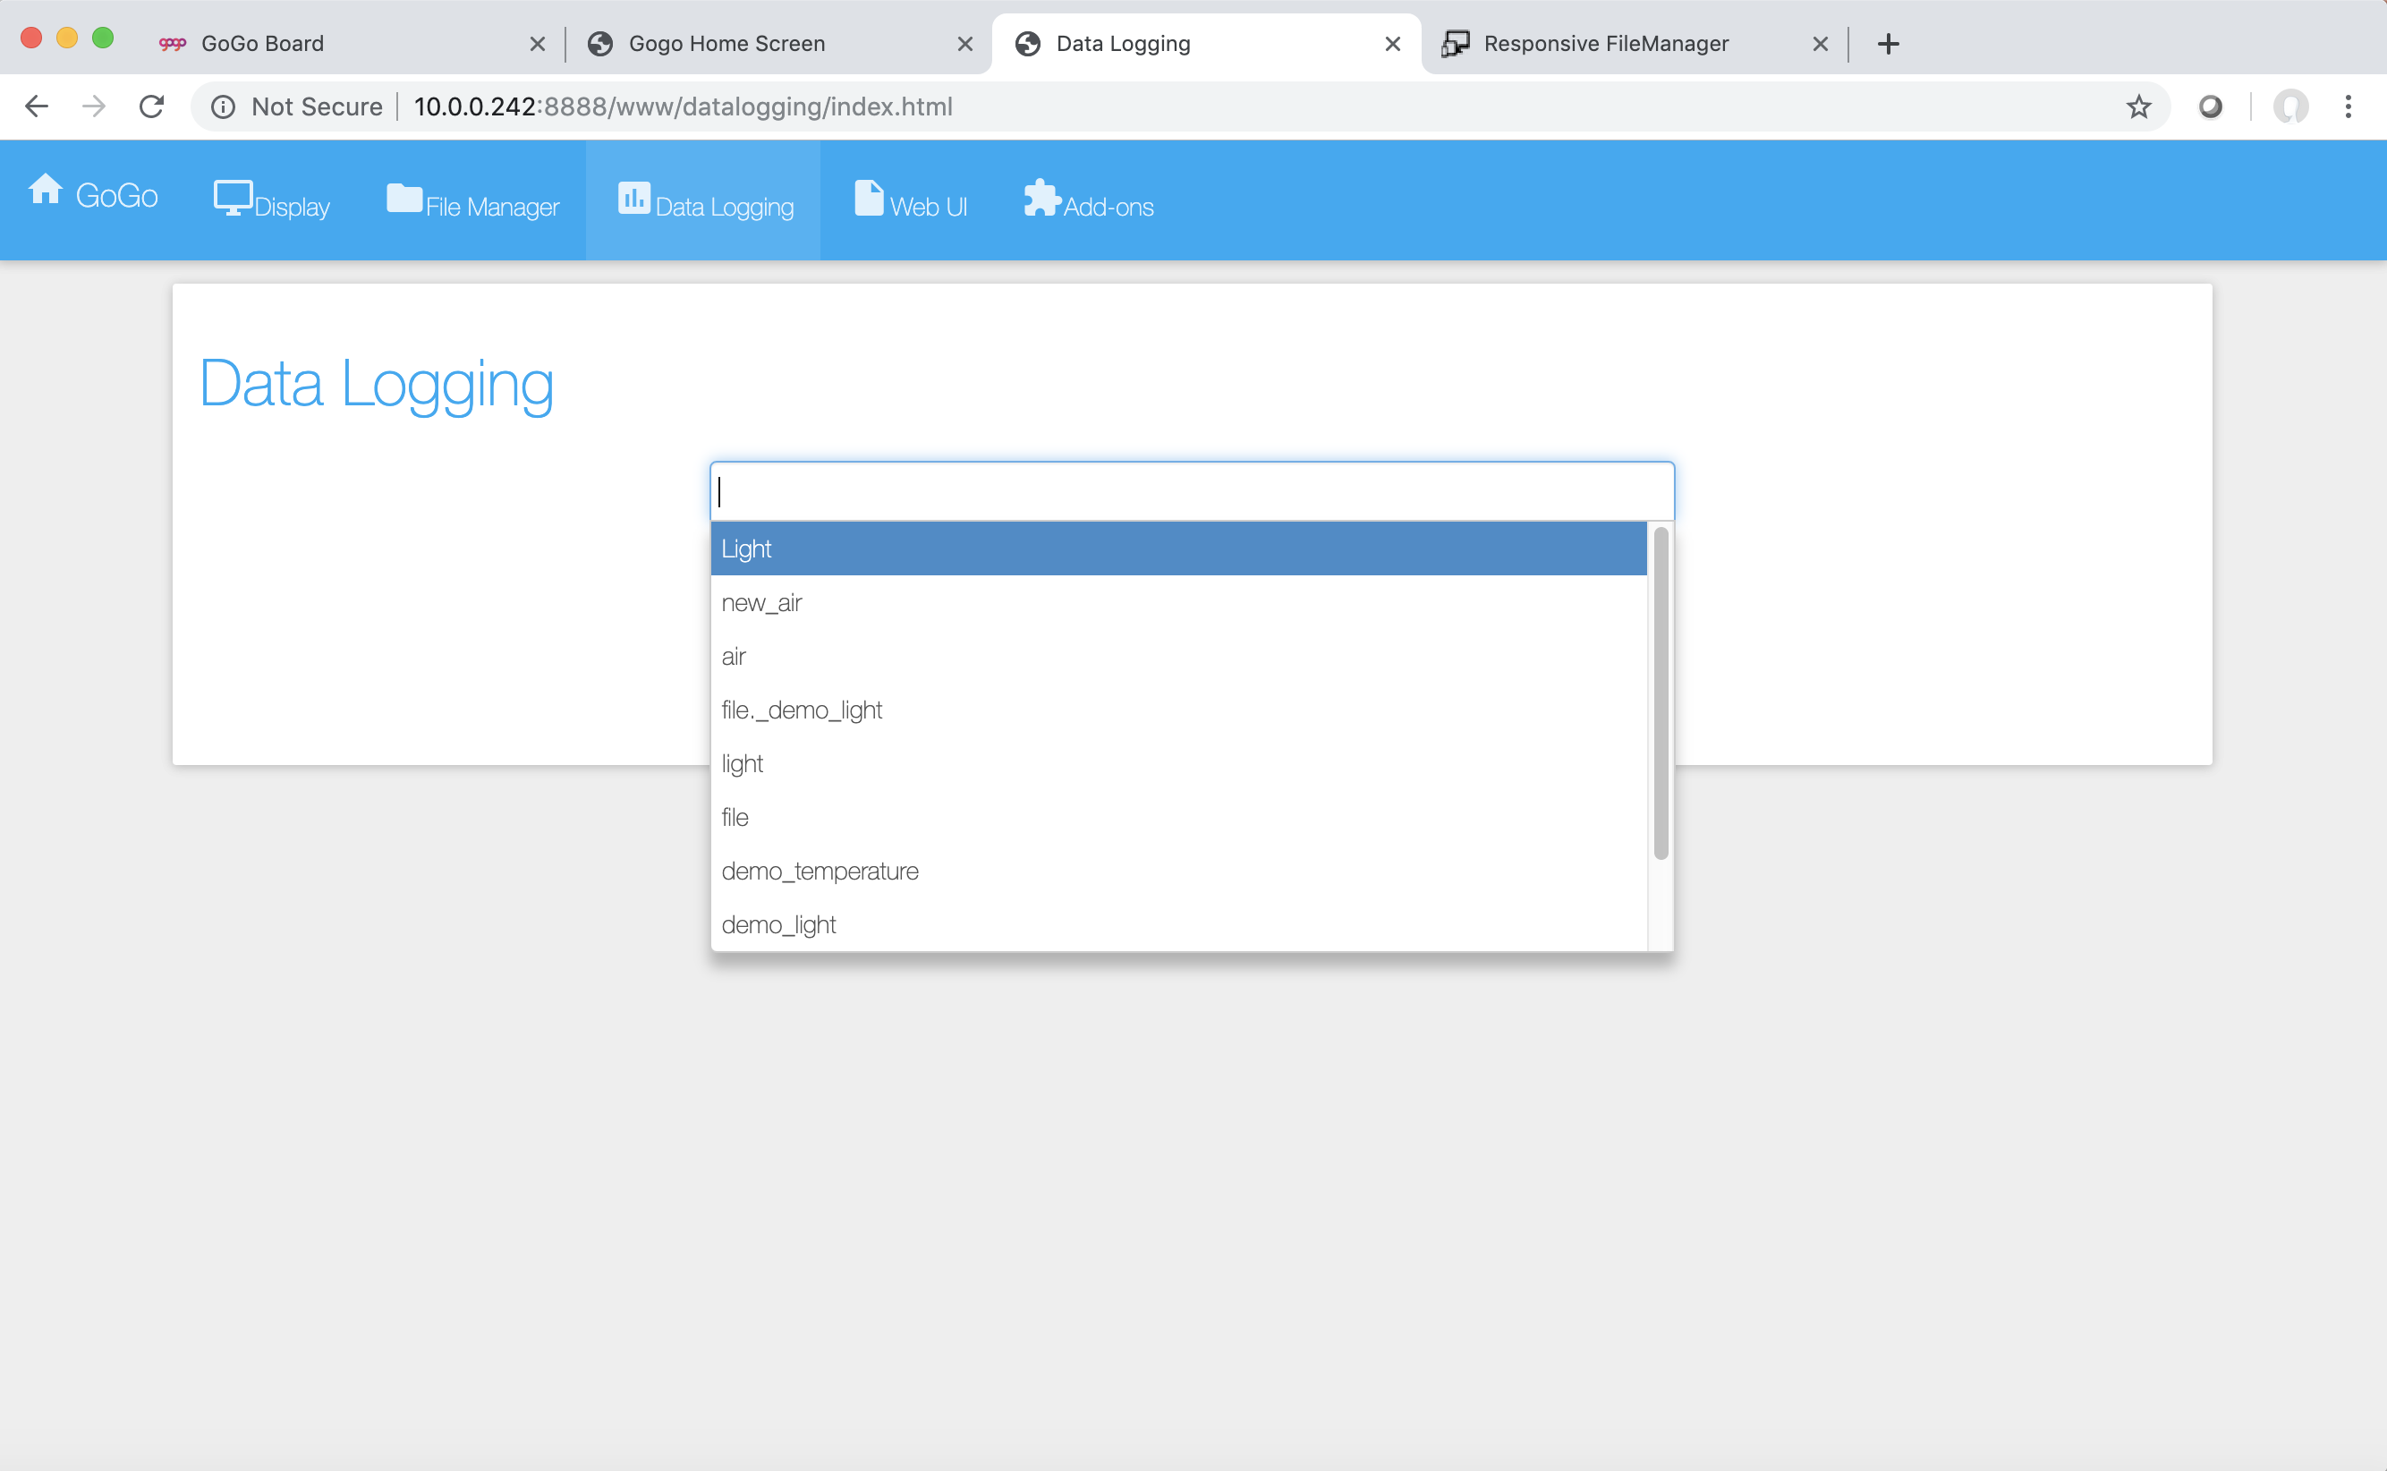
See recording in real time!
Select the sensor you want to watch!

Slide 30
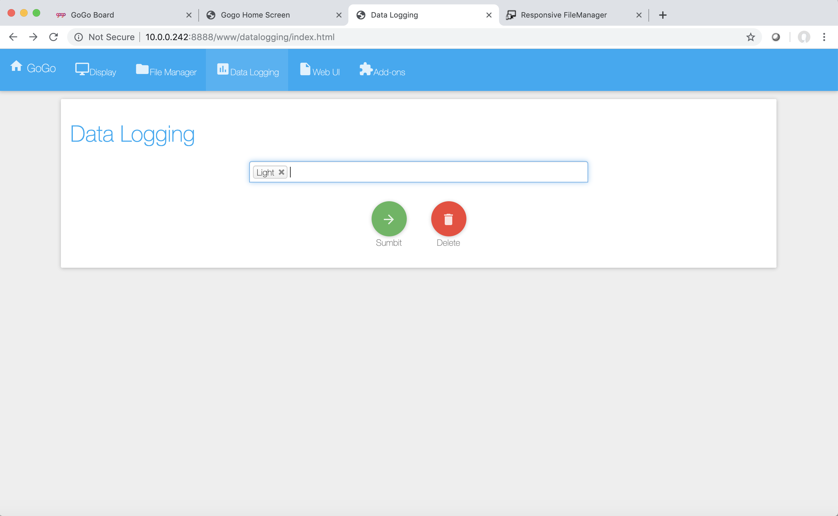
See recording in real time!
Select the sensor you want to watch!

Slide 31
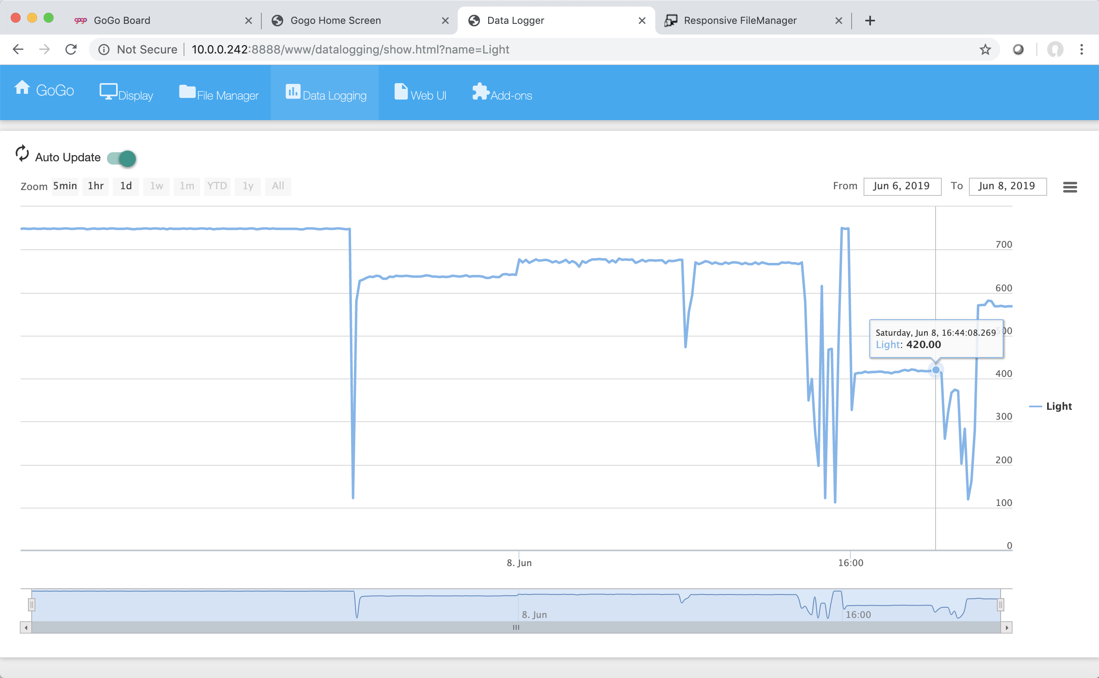
See recording in real time!
Can you make the sensor input change?

Slide 32
Design your own experiment, go outside and collect some data!! Tips: Record for 2 min

Slide 33
Retrieve data
Connect the GoGo Board back into your computer.
Make sure the Rasberry Pi is connected.
Click on the IP Address.

Slide 34
Retrieve data
Select Data Logging!

Slide 35
Retrieve data
Select the data you recorded!

Slide 36
Retrieve data
Select the data you recorded!

Slide 37
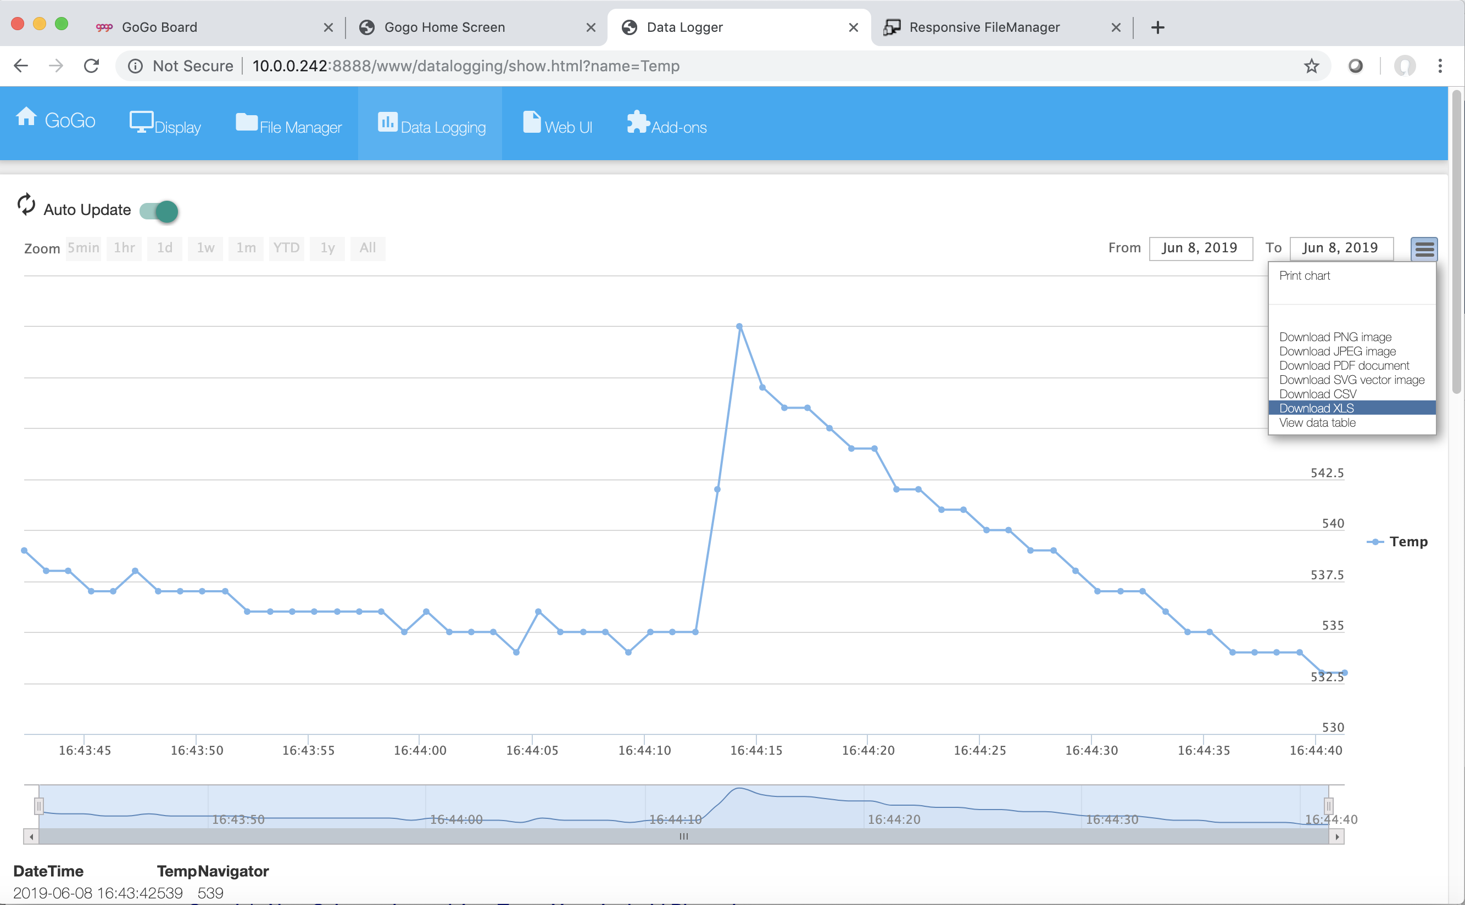
Retrieve data
What does your data says?
You can also download and open the data file using a spreadsheet!

Slide 38
Share!!

Slide 39
Why are these ideas important?

Slide 40
Papert’s Constructionism 1980
People “build” knowledge
Impersonal/abstract learning makes us hate education
Some ideas are more powerful than others (Microworlds)
Computing is necessary to make powerful representations of ideas personal and concrete (Logo)
Learning should be facilitated by teachers and mentors. It should not be a memorization/recitation process.

Slide 41
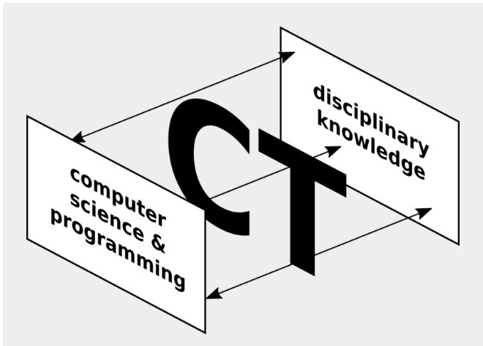
Developing a Framework for Computational Thinking
Understand (complex) systems.
Innovate with computational representations.
Design solutions that leverage computational power/resources.
Engage in collective sense making around data.
Understand potential consequences of actions.
Computational Thinking is formulating problems and their solutions in a way that a machine (computer) can be used to represent the problem and carry out its solution.

